Slide 1

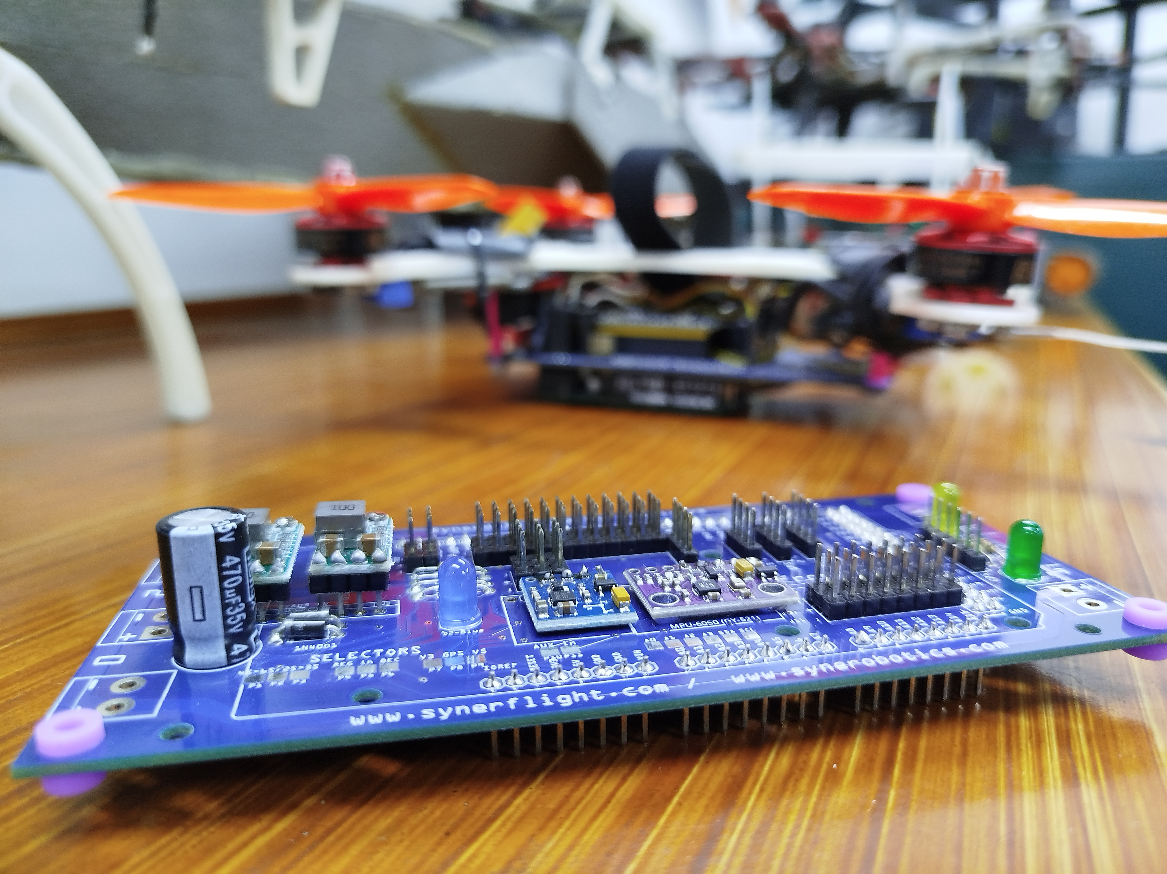



Program Logic
Synerduino STM
VERSIONS: F405, F411, H743
For more Information:
www.synerflight.com

Slide 2
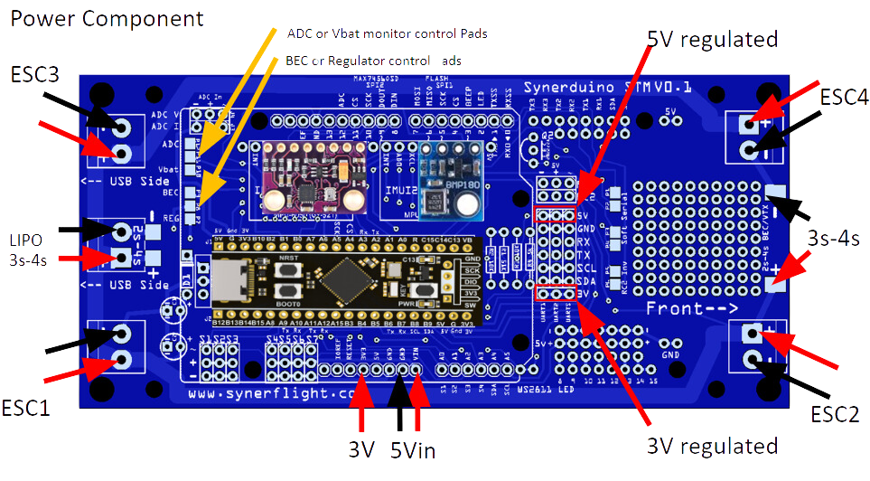
SYNERDUINO STM F411 SHIELD

Slide 3
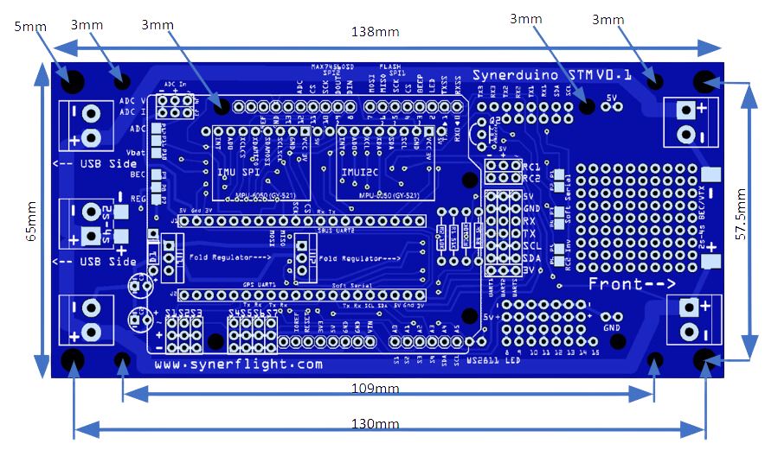
SYNERDUINO STM F411 SHIELD

Slide 4
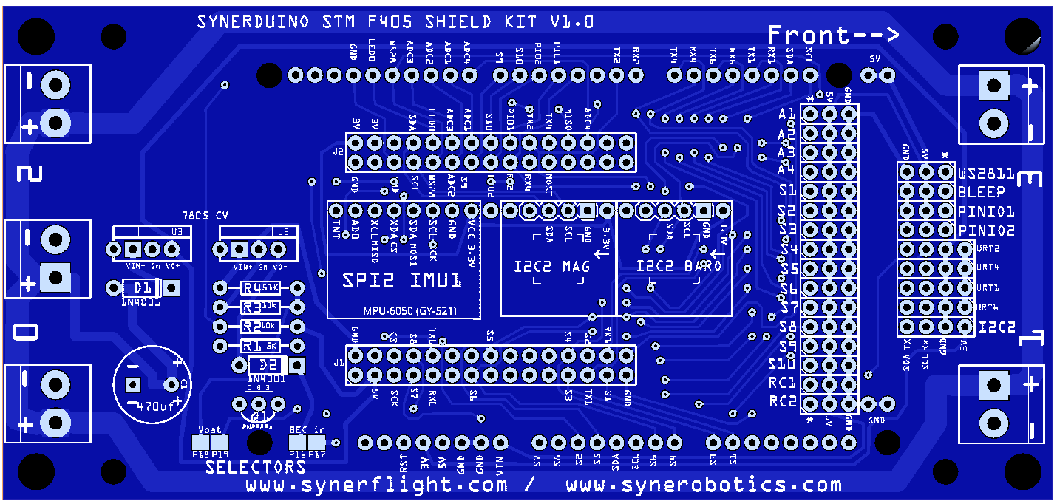
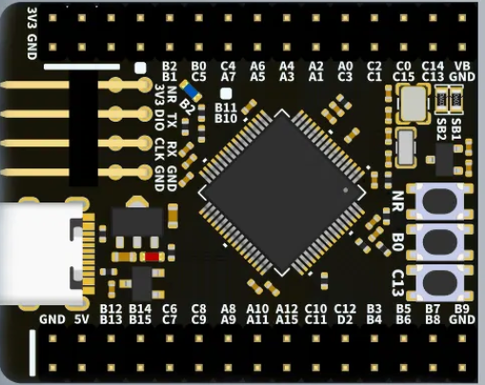
SYNERDUINO STM F405 SHIELD
Sensors must be covered with the provided housing glued into place using PVA white glue
ADC input headers
WS2811 & I/O
UART headers
PWM output headers
UBEC /Regulator Selection Pads
RC1 & RC2
ADC and Battery Monitoring

Slide 5
SYNERDUINO STM F405 SHIELD
SYNERDUINO STM F405
5mm
3mm
3mm
138mm
3mm
3mm
65mm
57.5mm
109mm
130mm

Slide 6
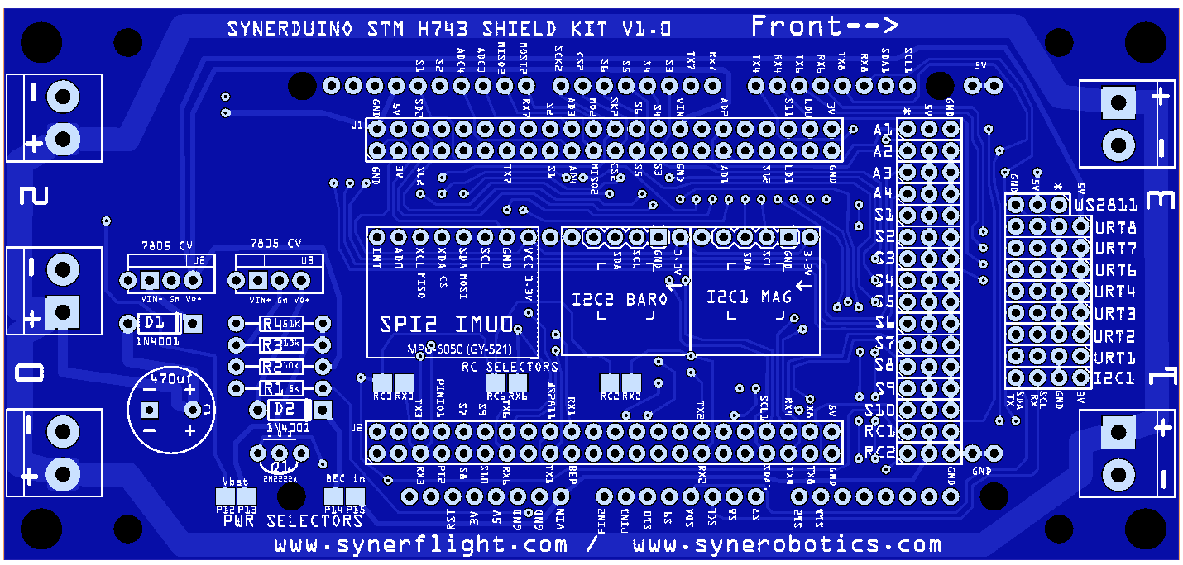
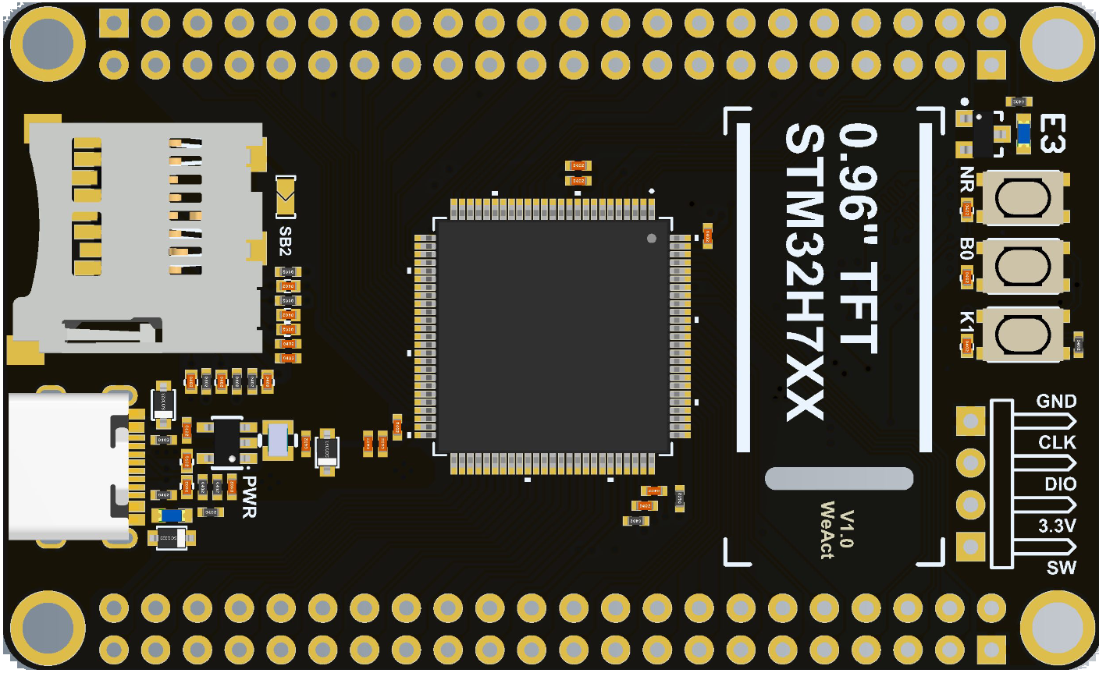
SYNERDUINO STM H743 SHIELD
Sensors must be covered with the provided housing glued into place using PVA white glue
ADC input headers
WS2811
PWM output headers
UART headers
i2C Headers
UBEC /Regulator Selection Pads
RC1 & RC2
ADC and Battery Monitoring

Slide 7
SYNERDUINO STM H743 SHIELD
5mm
3mm
3mm
138mm
3mm
3mm
65mm
57.5mm
109mm
130mm

Slide 8
SYNERDUINO STM
One of the Benefits of Using Synerduino Paired with INAV is it opens a Host of Possibility in Applications
MIXER SETUP
PROGRAM LOGIC
COMPANION BOARD
Here Represented just a Few samples

Slide 9
SETTING UP YOUR DRONE
MIXER for (INAV5-INAV6)
Note INAV5-INAV6 Synerduino STM has Two Firmware with different output arrangement for different vehicle types , (You can get creative in mixing for custom frame designs)
SYNERDUINOSTM.Hex (Default Loaded)
SYNERDUINOSTMSV.Hex
(TIM_USE_MC_MOTOR | TIM_USE_FW_MOTOR), // S1
(TIM_USE_MC_MOTOR | TIM_USE_FW_MOTOR), // S2
(TIM_USE_MC_MOTOR | TIM_USE_FW_SERVO), // S3
(TIM_USE_MC_MOTOR | TIM_USE_FW_SERVO), // S4
(TIM_USE_MC_MOTOR | TIM_USE_FW_SERVO), // S5
(TIM_USE_MC_MOTOR | TIM_USE_FW_SERVO), // S6
(TIM_USE_MC_SERVO | TIM_USE_FW_SERVO), // S7
(TIM_USE_MC_MOTOR | TIM_USE_FW_MOTOR), // S1
(TIM_USE_MC_MOTOR | TIM_USE_FW_MOTOR), // S2
(TIM_USE_MC_MOTOR | TIM_USE_FW_MOTOR), // S3
(TIM_USE_MC_MOTOR | TIM_USE_FW_MOTOR), // S4
(TIM_USE_MC_SERVO | TIM_USE_FW_SERVO), // S5
(TIM_USE_MC_SERVO | TIM_USE_FW_SERVO), // S6
(TIM_USE_MC_SERVO | TIM_USE_FW_SERVO), // S7
Vehicle Preset Mix
Vehicle Preset Mix
QUAD X
QUAD +
QUAD A-Tail
Y4
Y6
Hex X
Hex +
Hex H
FlyingWing
Airplane
Airplane No Rudder
Airplane V-Tail 2 Aileron Servo Airplane V-Tail 1 Aileron Servo
Other Stuff
Quad X W/ Gimbal
Quad + W/ Gimbal
Single Copter
Bi-Copter
Tricopter
Rover
Boat
Camera Gimbal
FlyingWing Differential thrust
Airplane Differential Thrust
Airplane V-Tail Differential Thrust
Other Stuff

Slide 10
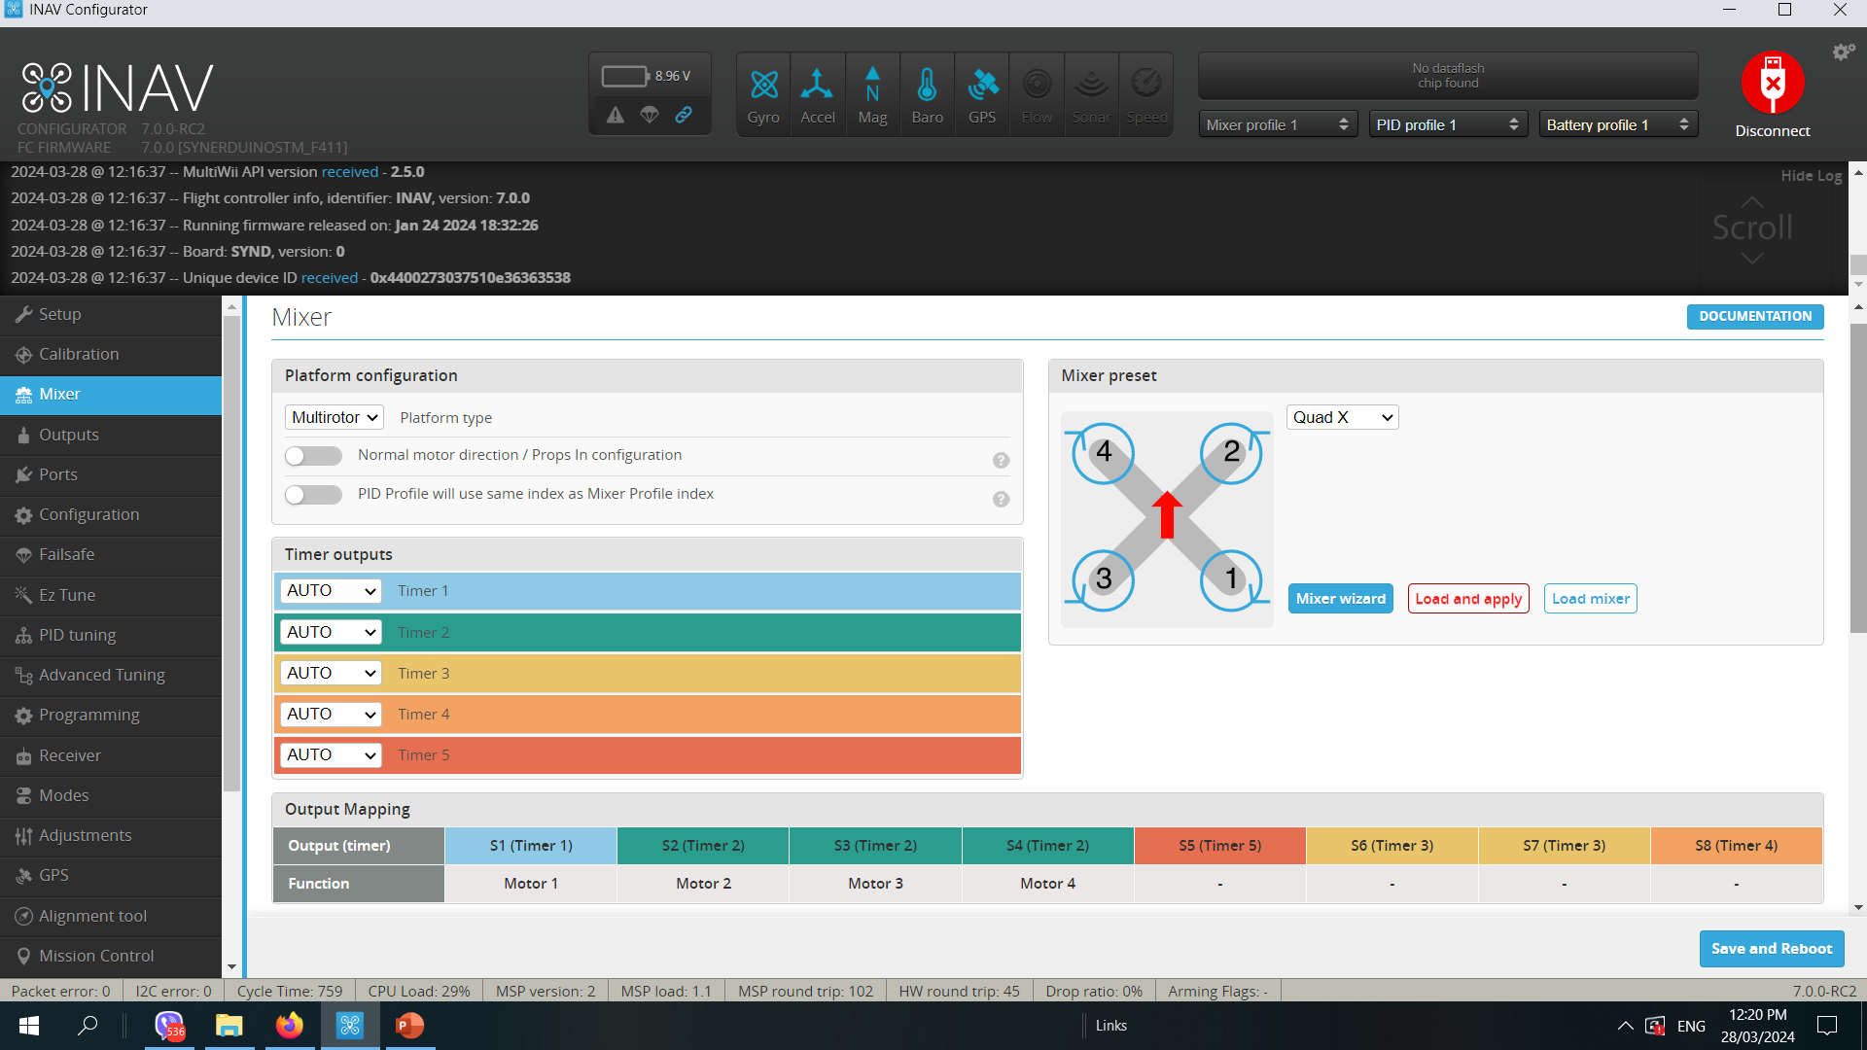
SETTING UP YOUR DRONE
MIXER (INAV 7-INAV 8)
Airframe or Vehicle time Preset and mix selection
Load and apply when selected then Save Reboot
Mixing is now color coded to timer availability
The Timer is Automatically assign to the corresponding PWM Pins as needed
This allows you to assign motor and servo function to your custom drone frame or payload requirement this eliminates the need to recompile a new firmware for custom frame types

Slide 11
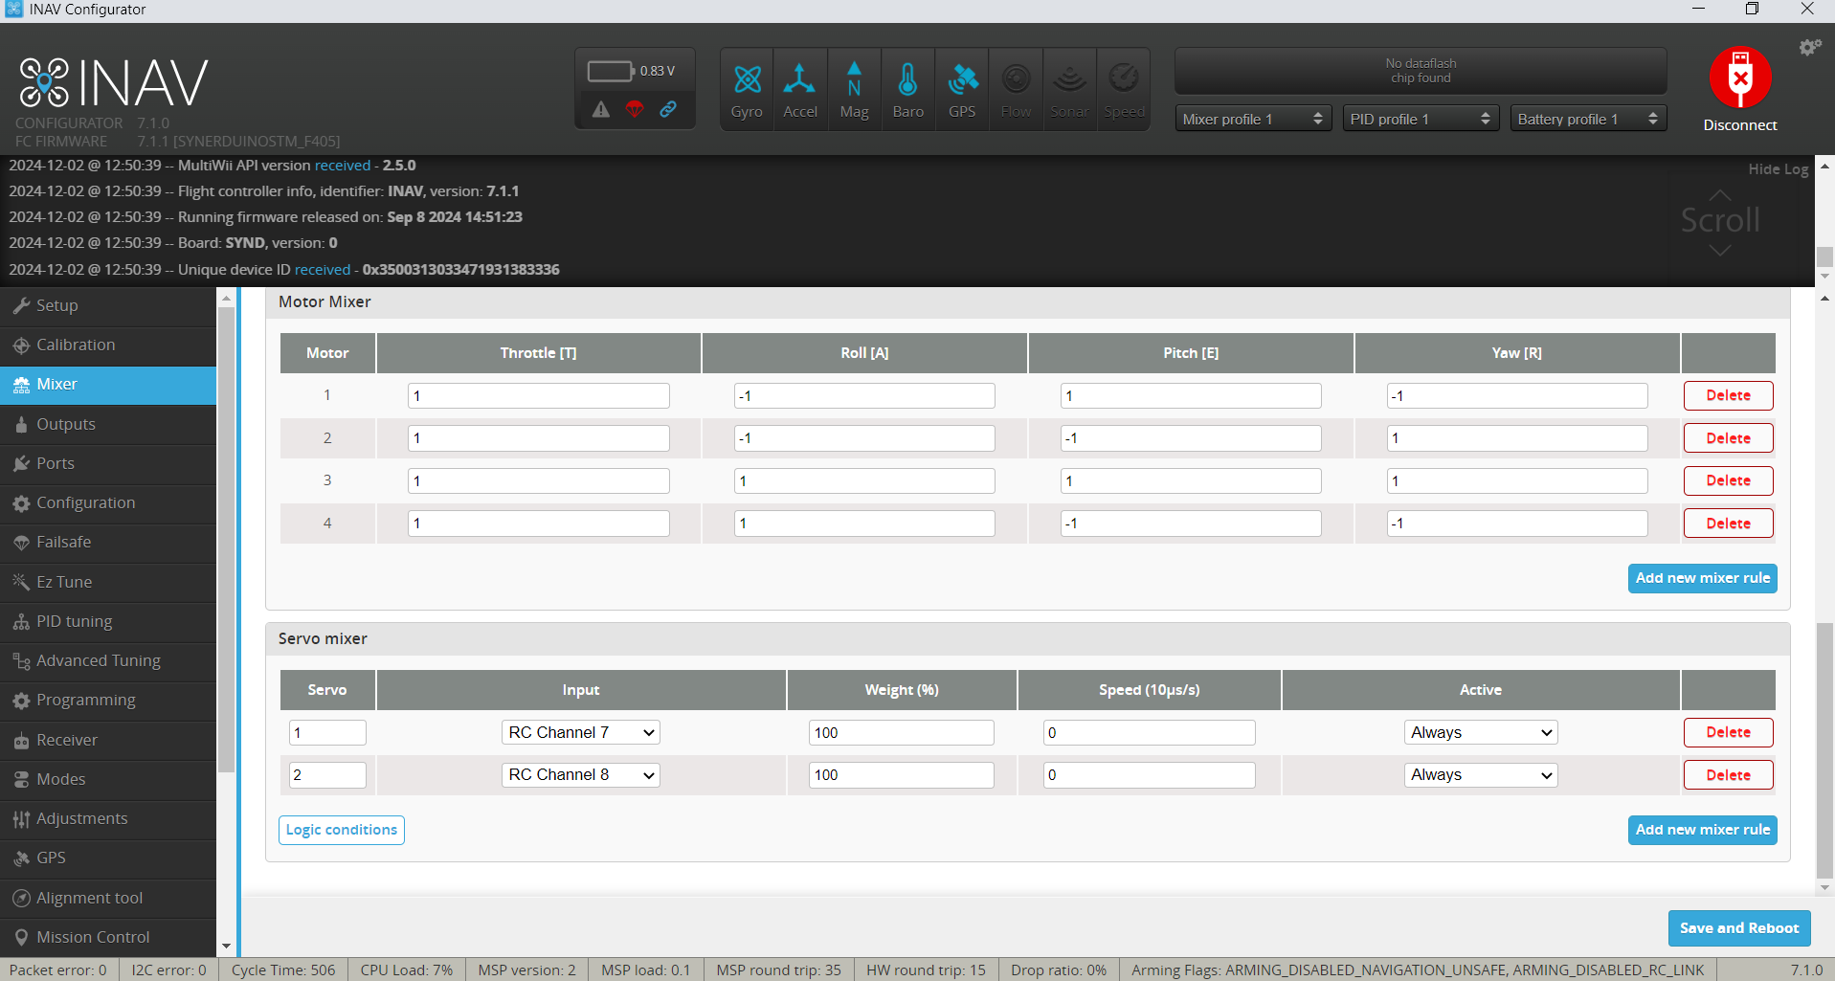
SETTING UP YOUR DRONE
Motor Mixer controls ESC control Elements of vehicle or Payload
Here you can add motors and Assign it Mixing
Servo Mixer control Servo elements of Vehicle or Payload
Here is where you can Add the Input assignment of the Servo

Slide 12
SERVO MIXING
Motor Mixing
A motor mixing rule is needed for each motor. Each rule defines weights that determine how the motor it applies to will change its speed relative to the requested throttle and flight dynamics: roll rate, pitch rate and yaw rate. The heigher a weight the more the input will have an impact on the speed of the motor. Refer to the following table for the meaning of each weight.
Weight | Definition
THROTTLE | Speed of the motor relative to throttle. Range [0.0, 1.0]. A motor with a weight of 0.5 will receive a command that will half of a motor with a 1.0 weight
ROLL | Indicates how much roll authority this motor imparts to the roll rate of the aircraft. Range [-1.0, 1.0]. For fixed wing models this is usually set to 0. A positive value means that the motor needs to accelerate for a positive roll rate request (rolling right). A negative value means that the motor needs to decelerate.
PITCH | Indicates how much pitch authority this motor imparts to the pitch rate of the aircraft. Range [-1.0, 1.0]. For fixed wing models this is usually set to 0. A positive value means that the motor needs to accelerate for a positive pitch rate request (pitching down). A negative value means that the motor needs to decelerate.
YAW | Indicates how much yaw authority this motor imparts to the yaw rate of the aircraft. Range [-1.0, 1.0]. For fixed wing models with more than one motor this weight can be used to setup differential thrust. For fixed wing models with only one motor this is usually set to 0. A positive value means that the motor needs to accelerate for a positive yaw rate request (clockwise yaw seen from the top of the model). A negative value means that the motor needs to decelerate

Slide 13
SERVO MIXING
CLI input ID | Mixer input | Description
0 | Stabilised ROLL | Roll command from the flight controller. Depends on the selected flight mode(s)
1 | Stabilised PITCH | Pitch command from the flight controller. Depends on the selected flight mode(s)
2 | Stabilised YAW | Yaw command from the flight controller. Depends on the selected flight mode(s)
3 | Stabilised THROTTLE | Throttle command from the flight controller. Depends on the selected flight mode(s)
4 | RC ROLL | Raw roll RC channel
5 | RC PITCH | Raw pitch RC channel
6 | RC YAW | Raw yaw RC channel
7 | RC THROTTLE | Raw throttle RC channel
8 | RC channel 5 | Raw RC channel 5
9 | RC channel 6 | Raw RC channel 6
10 | RC channel 7 | Raw RC channel 7
11 | RC channel 8 | Raw RC channel 8
12 | GIMBAL PITCH | Scaled pitch attitude of the aircraft [-90°, 90°] => [-500, 500]
13 | GIMBAL ROLL | Scaled roll attitude of the aircraft [-180°, 180°] => [-500, 500]
14 | FEATURE FLAPS | This input value is equal to the flaperon_throw_offset setting when the FLAPERON flight mode is enabled, 0 otherwise
15 | RC channel 9 | Raw RC channel 9
16 | RC channel 10 | Raw RC channel 10
17 | RC channel 11 | Raw RC channel 11
18 | RC channel 12 | Raw RC channel 12
19 | RC channel 13 | Raw RC channel 13
20 | RC channel 14 | Raw RC channel 14
21 | RC channel 15 | Raw RC channel 15
22 | RC channel 16 | Raw RC channel 16
23 | Stabilized ROLL+ | Clipped between 0 and 1000
24 | Stabilized ROLL- | Clipped between -1000 and 0
25 | Stabilized PITCH+ | Clipped between 0 and 1000
26 | Stabilized PITCH- | Clipped between -1000 and 0
27 | Stabilized YAW+ | Clipped between 0 and 1000
28 | Stabilized YAW- | Clipped between -1000 and 0
29 | MAX | Constant value of 500
Servo Mixing
At least one servo mixing rule is needed for each servo. Each rule defines how a servo will move relative to a specific input like a RC channel, or a requested flight dynamics rate or position from the flight controller.
Each servo mixing rule has the following parameters:
Servo index: defines which servo the rule will apply to. The absolute value of the index is not important, what matters is only the relative difference between the used indexes. The rule with the smaller servo index will apply to the first servo, the next higher servo index to the second servo, etc. More than one rule can use the same servo index. The output of the rules with the same servo index are added together to give the final output for the specified servo.
Input: the input for the mixing rule, see a summary of the input types table bellow.
Weight: percentage of the input to forward to the servo. Range [-1000, 1000]. Mixing rule output = input * weight. If the output of a set of mixing rules is lower/higher than the defined servo min/max the output is clipped (the servo will never travel farther than the set min/max).
Speed: maximum rate of change of the mixing rule output. Used to limit the servo speed. 1 corresponds to maximum 10µs/s output rate of change. Set to 0 for no speed limit. For example: 10 = full sweep (1000 to 2000) in 10s, 100 = full sweep in 1s.

Slide 14
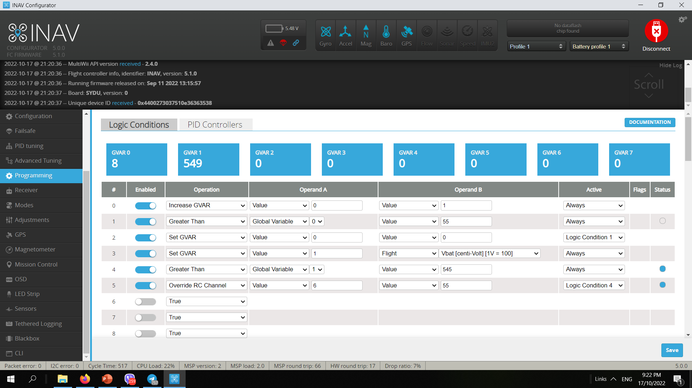
SYNERDUINO STM
One of the highlighted feature both hardware and software is its flexibility into adding new function to a Drone the combination of Synerduino hardware and INAV software makes this possible
Programmable Logic and Data Analytic Intervention allows you to add block like behavior control to your drone to respond to Environment , Sensor inputs and Conditions.
Operations - is the Logic function to conduct
Operand - A and B are the individual values and directors
Active – this has 2 option being always live or only live when the condition are met on the assign Logic conditions
Here Represented just a Few samples

Slide 15
PROGRAMMING
This is the definitive feature of INAV combine with the Synerduino STM Shield .
Is the Combination of ADC sensor with Programmable Logic functionality.
This PLC function allows you to program upto 8 GVAR and 64 instructions line from timer to sensor conditions to trigger a Flight mode action or control action of your Drone
And in certain application it skips the need of an onboard companion computer reducing the vehicle platform size
This feature can be use in multiple applications . Selective payload deployment , hardware trigger , Gimbal stabilization , failsafe ,geofence , data respond and more

Slide 16
OPERATIONS
Operation ID | Name | Notes
0 | TRUE | Always evaluates as true
1 | EQUAL | Evaluates false if false or 0
2 | GREATER_THAN | true if Operand A is a higher value than Operand B
3 | LOWER_THAN | true if Operand A is a lower value than Operand B
4 | LOW | true if <1333
5 | MID | true if >=1333 and <=1666
6 | HIGH | true if >1666
7 | AND | true if Operand A and Operand B are the same value or both true
8 | OR | true if Operand A and/or OperandB is true
9 | XOR | true if Operand A or Operand B is true, but not both
10 | NAND | false if Operand A and Operand B are both true
11 | NOR | true if Operand A and Operand B are both false
12 | NOT | The boolean opposite to Operand A
13 | STICKY | Operand A is activation operator, Operand B is deactivation operator. After activation, operator will return true until Operand B is evaluated as true
14 | ADD | Add Operand A to Operand B and returns the result
15 | SUB | Substract Operand B from Operand A and returns the result
16 | MUL | Multiply Operand A by Operand B and returns the result
17 | DIV | Divide Operand A by Operand B and returns the result
18 | GVAR SET | Store value from Operand B into the Global Variable addressed by Operand B. Bear in mind, that operand Global Variable means: Value stored in Global Variable of an index! To store in GVAR 1 use Value 1 not Global Variable 1
19 | GVAR INC | Increase the GVAR indexed by Operand A with value from Operand B
20 | GVAR DEC | Decrease the GVAR indexed by Operand A with value from Operand B
21 | IO PORT SET | Set I2C IO Expander pin Operand A to value of Operand B. Operand A accepts values 0-7 and Operand B accepts 0 and 1
22 | OVERRIDE_ARMING_SAFETY | Allows to arm on any angle even without GPS fix
23 | OVERRIDE_THROTTLE_SCALE | Override throttle scale to the value defined by operand. Operand type 0 and value 50 means throttle will be scaled by 50%.

Slide 17
OPERATIONS
Operation ID | Name | Notes
24 | SWAP_ROLL_YAW | basically, when activated, yaw stick will control roll and roll stick will control yaw. Required for tail-sitters VTOL during vertical-horizonral transition when body frame changes
25 | SET_VTX_POWER_LEVEL | Sets VTX power level. Accepted values are 0-3 for SmartAudio and 0-4 for Tramp protocol
26 | INVERT_ROLL | Inverts ROLL axis input for PID/PIFF controller
27 | INVERT_PITCH | Inverts PITCH axis input for PID/PIFF controller
28 | INVERT_YAW | Inverts YAW axis input for PID/PIFF controller
29 | OVERRIDE_THROTTLE | Override throttle value that is fed to the motors by mixer. Operand is scaled in us. 1000 means throttle cut, 1500 means half throttle
30 | SET_VTX_BAND | Sets VTX band. Accepted values are 1-5
31 | SET_VTX_CHANNEL | Sets VTX channel. Accepted values are 1-8
32 | SET_OSD_LAYOUT | Sets OSD layout. Accepted values are 0-3
33 | SIN | Computes SIN of Operand A value in degrees. Output is multiplied by Operand B value. If Operand B is 0, result is multiplied by 500
34 | COS | Computes COS of Operand A value in degrees. Output is multiplied by Operand B value. If Operand B is 0, result is multiplied by 500
35 | TAN | Computes TAN of Operand A value in degrees. Output is multiplied by Operand B value. If Operand B is 0, result is multiplied by 500
36 | MAP_INPUT | Scales Operand A from [0 : Operand B] to [0 : 1000]. Note: input will be constrained and then scaled
37 | MAP_OUTPUT | Scales Operand A from [0 : 1000] to [0 : Operand B]. Note: input will be constrained and then scaled
38 | RC_CHANNEL_OVERRIDE | Overrides channel set by Operand A to value of Operand B
39 | SET_HEADING_TARGET | Sets heading-hold target to Operand A, in degrees. Value wraps-around.
40 | MOD | Divide Operand A by Operand B and returns the remainder
41 | LOITER_RADIUS_OVERRIDE | Sets the loiter radius to Operand A [0 : 100000] in cm. If the value is lower than the loiter radius set in the Advanced Tuning, that will be used.
42 | SET_PROFILE | Sets the active config profile (PIDFF/Rates/Filters/etc) to Operand A. Operand A must be a valid profile number, currently from 1 to 3. If not, the profile will not change
43 | MIN | Finds the lowest value of Operand A and Operand B
44 | MAX | Finds the highest value of Operand A and Operand B
45 | FLIGHT_AXIS_ANGLE_OVERRIDE | Sets the target attitude angle for axis. In other words, when active, it enforces Angle mode (Heading Hold for Yaw) on this axis (Angle mode does not have to be active). Operand A defines the axis: 0 - Roll, 1 - Pitch, 2 - Yaw. Operand B defines the angle in degrees
46 | FLIGHT_AXIS_RATE_OVERRIDE | Sets the target rate (rotation speed) for axis. Operand A defines the axis: 0 - Roll, 1 - Pitch, 2 - Yaw. Operand B defines the rate in degrees per second

Slide 18
OPERANDS
Operand Type | Name | Notes
0 | VALUE | Value derived from value field
1 | GET_RC_CHANNEL | value points to RC channel number, indexed from 1
2 | FLIGHT | value points to flight parameter table
3 | FLIGHT_MODE | value points to flight modes table
4 | LC | value points to other logic condition ID
5 | GVAR | Value stored in Global Variable indexed by value. GVAR 1 means: value in GVAR 1
5 | PID | Output of a Programming PID indexed by value. PID 1 means: value in PID 1

Slide 19
FLIGHT
Operand Value | Name | Notes
0 | ARM_TIMER | in seconds
1 | HOME_DISTANCE | in meters
2 | TRIP_DISTANCE | in meters
3 | RSSI
4 | VBAT | in Volts * 100, eg. 12.1V is 1210
5 | CELL_VOLTAGE | in Volts * 100, eg. 12.1V is 1210
6 | CURRENT | in Amps * 100, eg. 9A is 900
7 | MAH_DRAWN | in mAh
8 | GPS_SATS
9 | GROUD_SPEED | in cm/s
10 | 3D_SPEED | in cm/s
11 | AIR_SPEED | in cm/s
12 | ALTITUDE | in cm
13 | VERTICAL_SPEED | in cm/s
14 | TROTTLE_POS | in %
15 | ATTITUDE_ROLL | in degrees
16 | ATTITUDE_PITCH | in degrees
17 | IS_ARMED | boolean 0/1
18 | IS_AUTOLAUNCH | boolean 0/1
19 | IS_ALTITUDE_CONTROL | boolean 0/1
20 | IS_POSITION_CONTROL | boolean 0/1

Slide 20
FLIGHT
Operand Value | Name | Notes
21 | IS_EMERGENCY_LANDING | boolean 0/1
22 | IS_RTH | boolean 0/1
23 | IS_WP | boolean 0/1
24 | IS_LANDING | boolean 0/1
25 | IS_FAILSAFE | boolean 0/1
26 | STABILIZED_ROLL | Roll PID controller output [-500:500]
27 | STABILIZED_PITCH | Pitch PID controller output [-500:500]
28 | STABILIZED_YAW | Yaw PID controller output [-500:500]
29 | ACTIVE_WAYPOINT_INDEX | Indexed from 1. To verify WP is in progress, use IS_WP
30 | ACTIVE_WAYPOINT_ACTION | See ACTIVE_WAYPOINT_ACTION paragraph
31 | 3D HOME_DISTANCE | in meters, calculated from HOME_DISTANCE and ALTITUDE using Pythagorean theorem
32 | CROSSFIRE LQ | Crossfire Link quality as returned by the CRSF protocol
33 | CROSSFIRE SNR | Crossfire SNR as returned by the CRSF protocol
34 | GPS_VALID | boolean 0/1. True when the GPS has a valid 3D Fix
35 | LOITER_RADIUS | The current loiter radius in cm.
36 | ACTIVE_PROFILE | integer for the active config profile [1..MAX_PROFILE_COUNT]
37 | BATT_CELLS | Number of battery cells detected
38 | AGL_STATUS | boolean 1 when AGL can be trusted, 0 when AGL estimate can not be trusted
39 | AGL | integer Above The Groud Altitude in cm
40 | RANGEFINDER_RAW | integer raw distance provided by the rangefinder in cm

Slide 21
FLIGHT
ACTIVE_WAYPOINT_ACTION
FLIGHT_MODE
Action | Value
WAYPOINT | 1
HOLD_TIME | 3
RTH | 4
SET_POI | 5
JUMP | 6
SET_HEAD | 7
LAND | 8
Operand Value | Name
0 | FAILSAFE
1 | MANUAL
2 | RTH
3 | POSHOLD
4 | CRUISE
5 | ALTHOLD
6 | ANGLE
7 | HORIZON
8 | AIR
9 | USER1
10 | USER2

Slide 22
PROGRAMING LOGIC SAMPLE
One of the Defining Feature of the Synerduino STM and INAV combine is you can configure the Controller as an PLC this means you can introduce an cause and effect behavior to the drone too do a certain action when condition variable is in effect.
Some sample one could create behavior
Tilt Trigger
Low Battery Failsafe
Geofence
Waypoint Trigger
Camera Gimbal
Data Analytic Intervention
Flight Mode override
etc,
The Following are selected sample to help you to understand how programming works

Slide 23
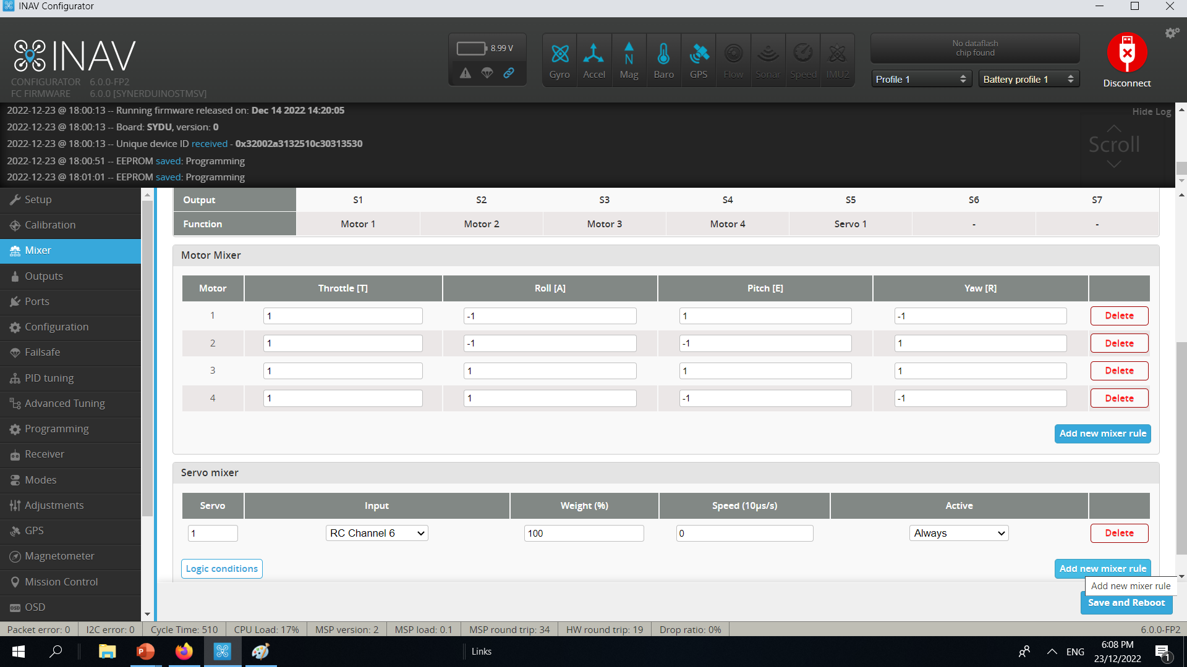
Tilt Trigger sample
In this Programing sample we’ll be triggering a servo when the drone tilt more than 10 degrees to the right
This application can be use to
deploy payload
Stabilization gimbal
trigger a companion hardware to perform a task
In Mixer tab add new Mixer Rule to RC channel 6
Servo S7 Pin
Servo S5 Pin
SYNERDUINOSTM.Hex
SYNERDUINOSTMSV.Hex

Slide 24
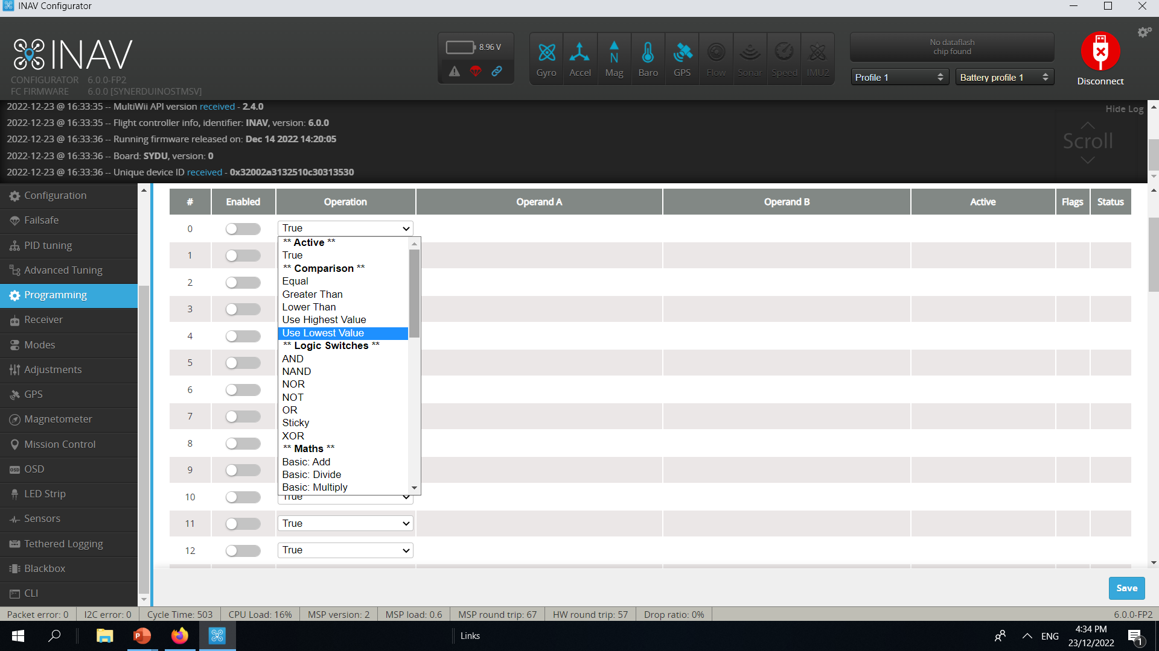
Tilt Trigger sample
Inav has Programming value you can instruct Conditions to and when to conditions are Valid it can be use to trigger an action that the Synerduino would do.
This can serve basic
failsafe function
Geofence
Servo trigger
To more complex
Mission conditions
Events Conditions

Slide 25
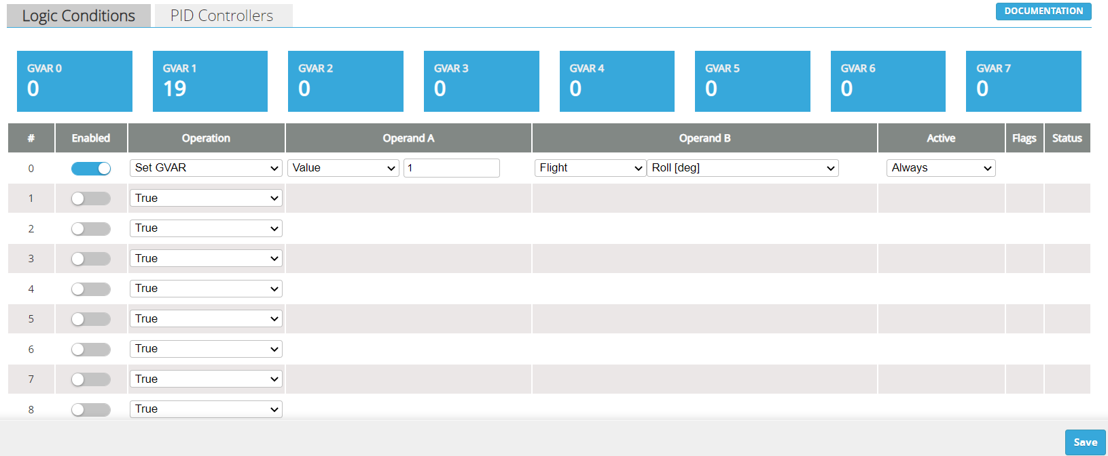
Tilt Trigger sample
In this Sample
Operation
-this instruct the type of operation the programming is to perform
#0
Set GVAR
Operand A
- Then we instruct the value
– set which GVAR to write on
Set GVAR to Value 1
GVAR1
Operand B
-here we want to capture flight data
This example is Roll (degree)
Meaning it captures the roll in angle of the Synerduino shield
Active
means the platform is always active and constant listening to the Roll angle
In this Sample when the Drone roll greater than 10 degrees to the right the servo on S5 triggers
Note: Mixer Tab the Servo

Slide 26
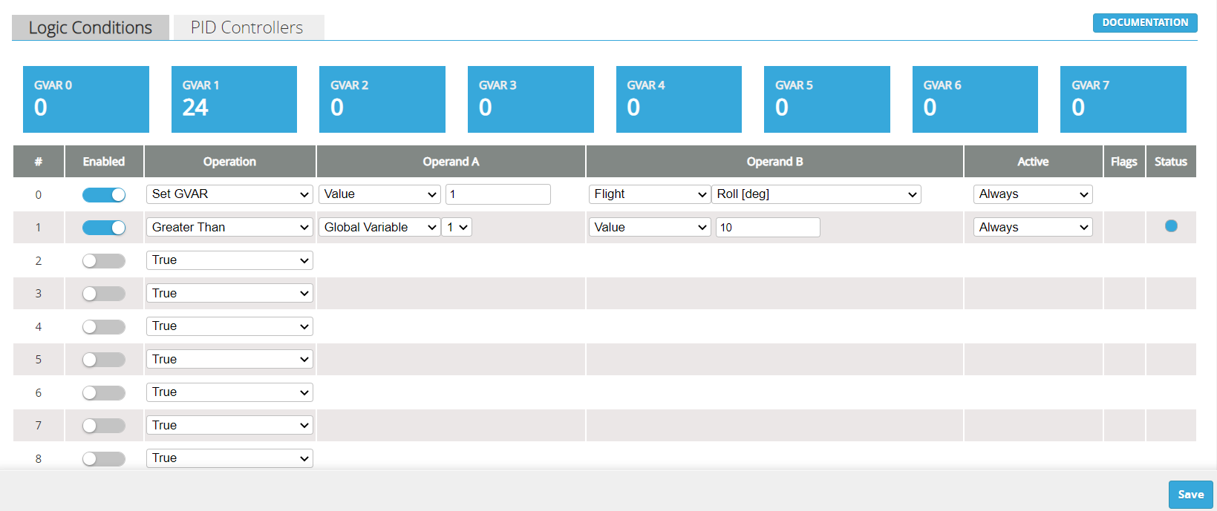
Tilt Trigger sample
Operation
-this instruct the type of operation the programming is to perform
# 1
Greater than (Conditions)
Operand A
-We want to Extract information from GAVR 1 (Global Variable 1)
Operand B
if the Value is 10 (Degrees)
This example is Roll (degree)
Active
means the platform is always active and constant listening to the Roll angle
Status
This will trigger if the Value greater than 10 degrees is met it should indicate

Slide 27
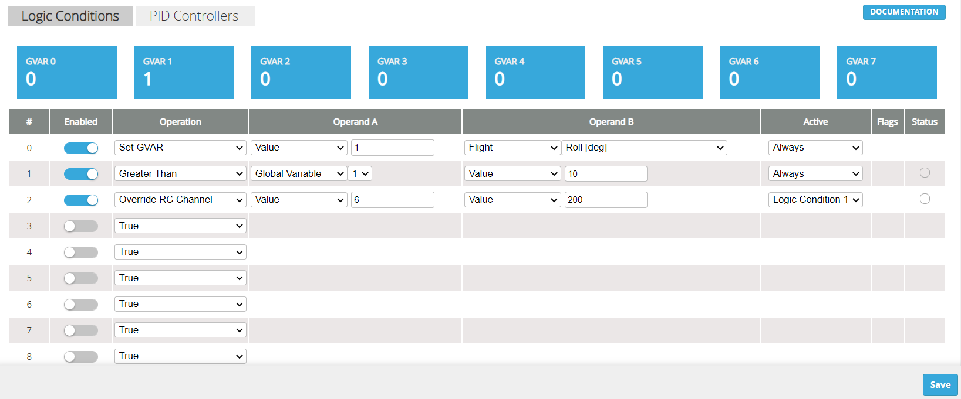
Tilt Trigger sample
In this Sample
Operation
-this instruct the type of operation the programming is to perform
#2
Override RC channel
Operand A
Value6 (RC Channel 6 or Aux2)
Operand B
Value 200 (Degrees of servo plugged into Channel 6)
Active
Logic condition 1
It looks at the Condition 1 if its status is active then the condition is true to trigger the servo

Slide 28
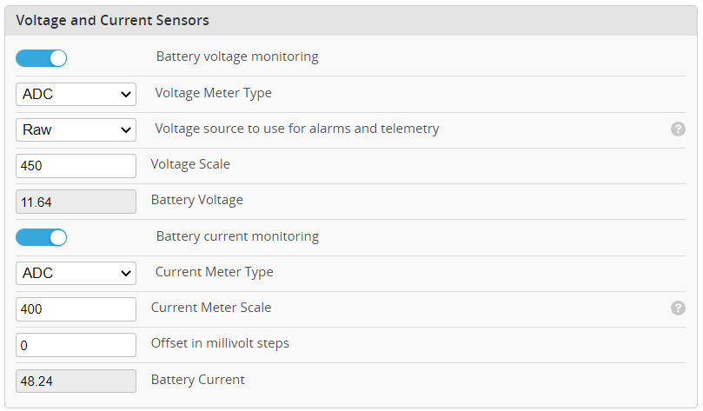


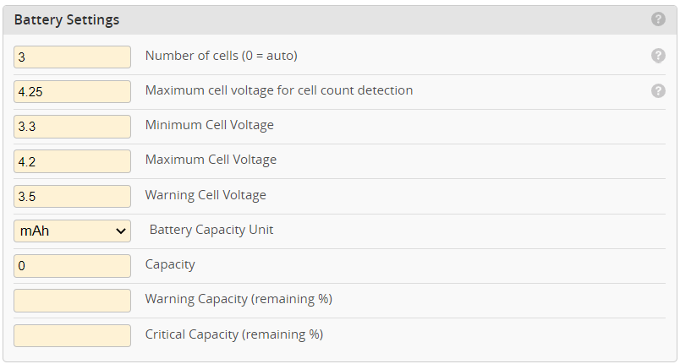

Low Battery Failsafe
Before a Low battery failsafe RTH can be setup you needed to configure your battery Cell count and Voltage scale
You can cross calibrate this with an separate battery monitoring buzzer
This would define your signal point on where to trigger.
P11-P10 is Vbat to read from the battery input as battery monitoring voltage

Slide 29
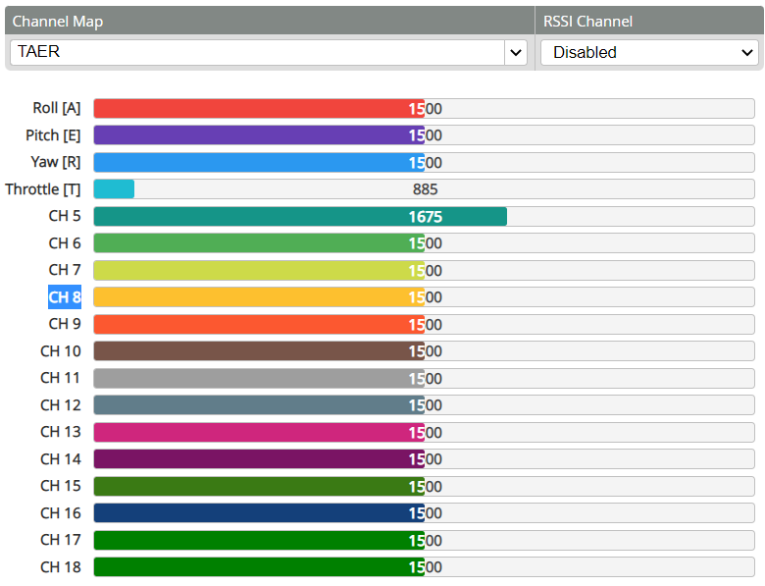

Low Battery Failsafe
An empty Channel needed to be chosen for the trigger point.
In this case CH8

Slide 30

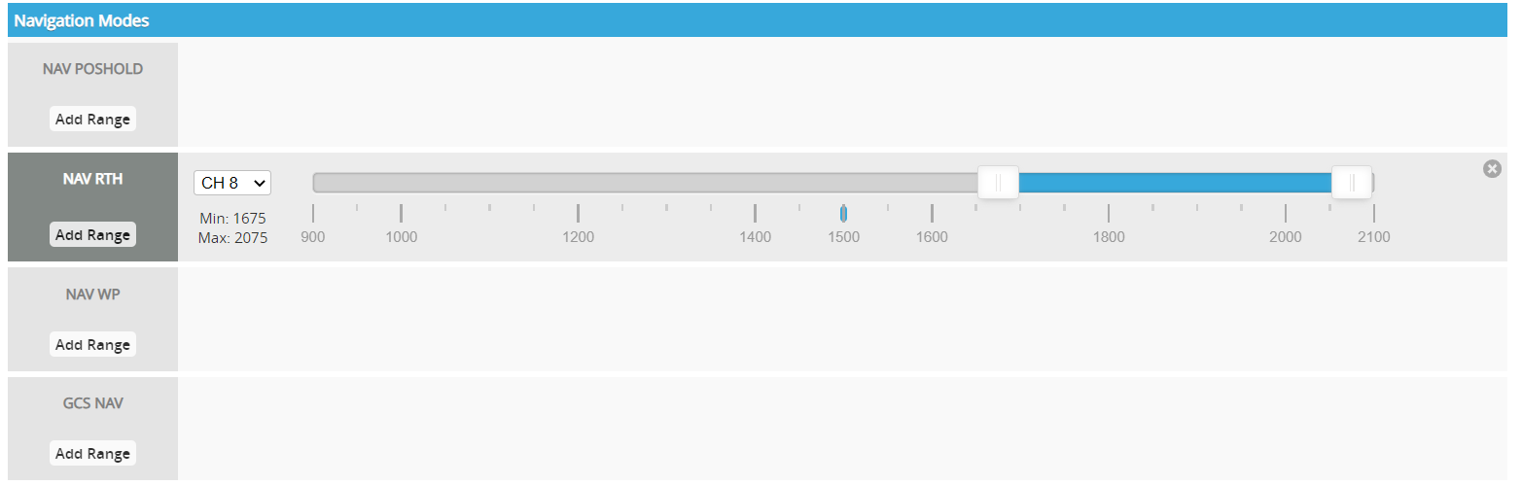
Low Battery Failsafe
In NAV RTH a channel associated to it needs to be configure to that flight mode
In this case CH8

Slide 31
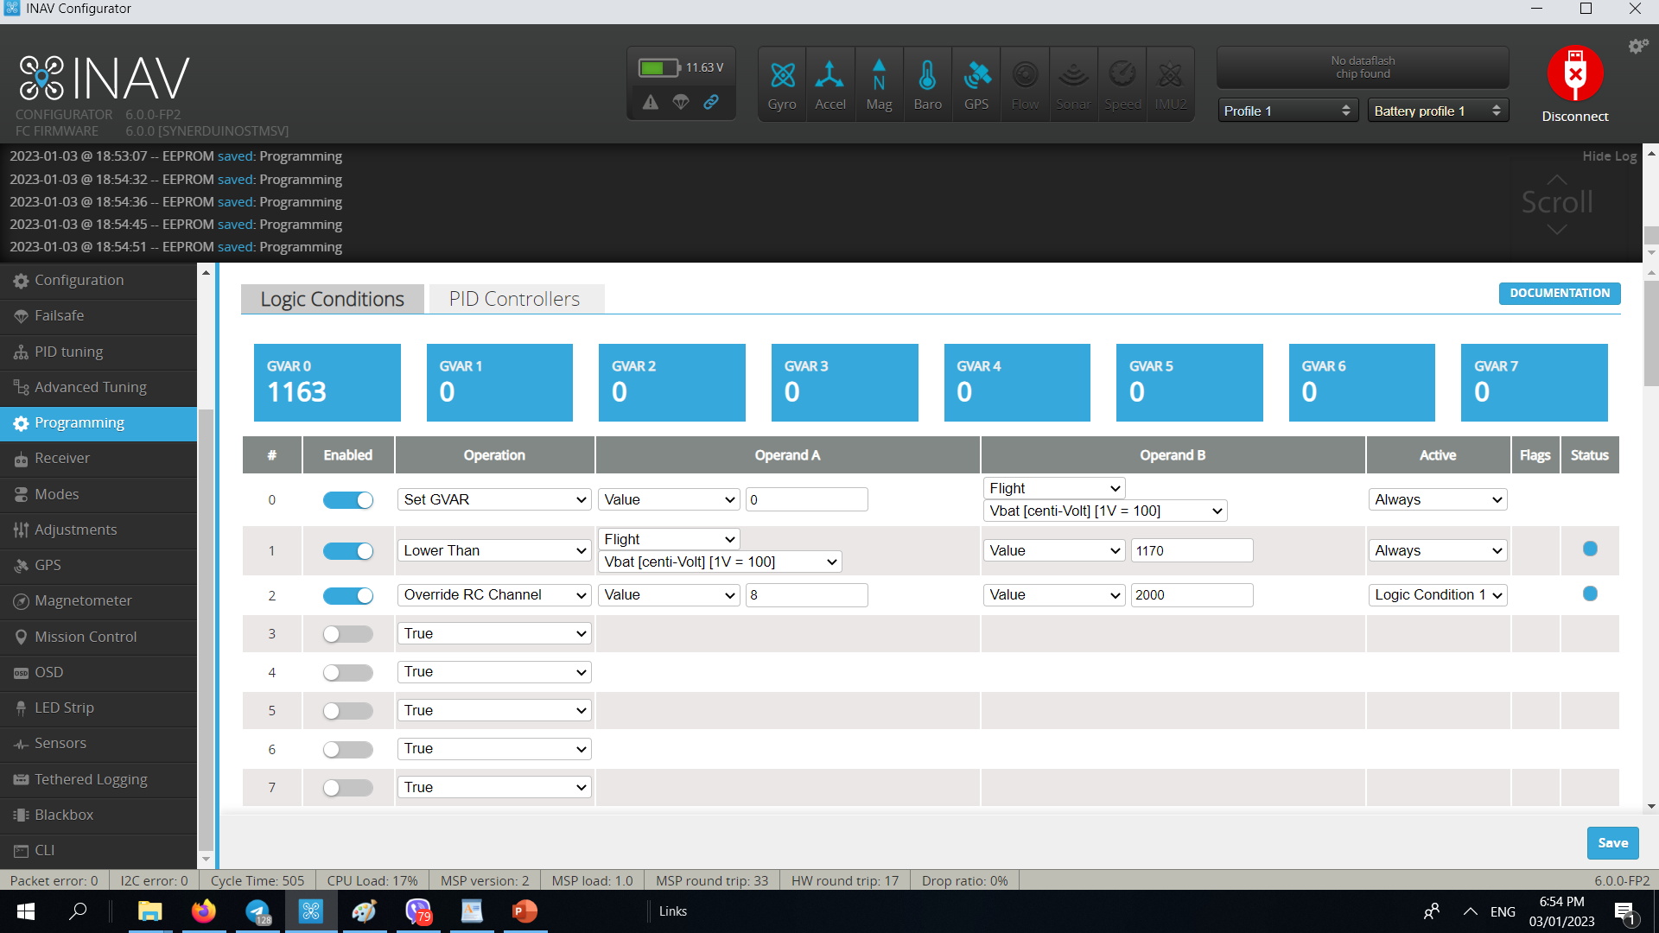
Low Battery Failsafe
0# set GVAR
Operand A = Value 0
Operand B = Flight Vbat Volt
Active = Always
First we need to visualize the Voltage in this case 11.63v or GVAR0 1163
1# Lower than
Operand A = Flight Vbat Volt
Operand B = Value 1170
Active = Always
Here we set an sample that if the Vbat Volt is is Lower than 11.70V or 1170 the status would trigger but if its higher lets say 12.00V or 1200 than the Status would stay off
2# Override RC Channel
Operand A = Value 8
Operand B = Value 2000
Active = Logic condition 1
Here is where the magic happens when the conditions are met in Logic #1 with a active Status this would trigger the Value 8 (Ch8) to set PWM to 2000 overriding the RC input and triggering the RTH in Modes. This puts the drone to a RTH mode.
This sample also can be utilized for Data Analytics intervention
c

Slide 32
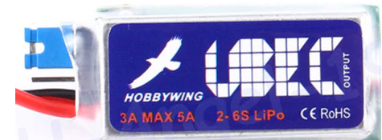

Waypoint Trigger
UBEC is Required for High current applications if it exceeded more than
3A for STMF405 and H743
1.5A for F411 of use when driving servos
BEC input requirements must be 5V
Waypoint trigger is useful for triggering payload or drone function when its above a waypoint assign to it
External ADC Sensor
11.1V Lipo
S7
S8
Any unused Pins can be assigned in the mixer for the task

Slide 33
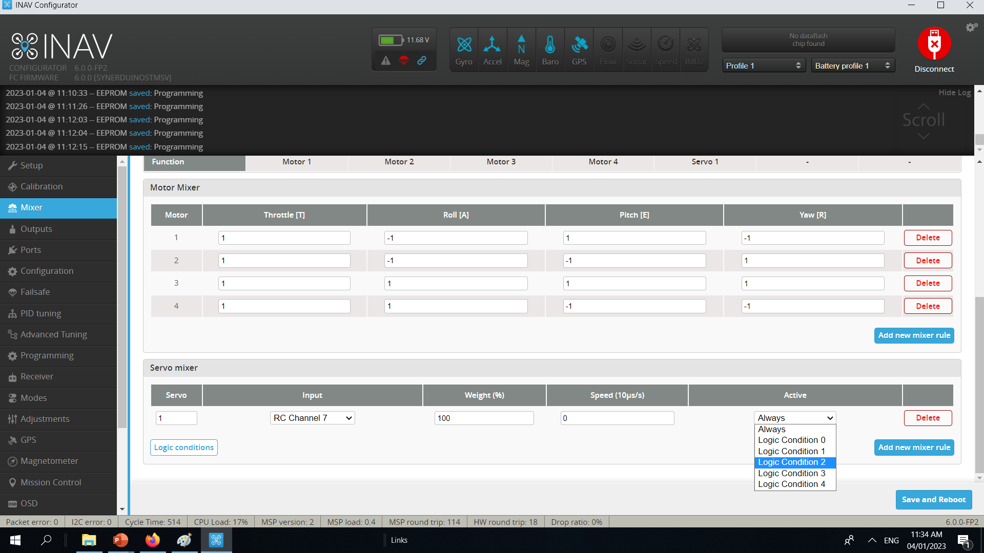

Waypoint Trigger
INAV5 – INAV6
In Mixer RC channel 7 is associated to servo1
S1 on SYNERDUINOSTM.HEX
S5 on SYNERDUINOSTMSV.HEX
Logic condition can also be added to the mixer removing the need to add 3# Logic condition in the Programming
Servos can be reverse by giving it a negative value on Weight% -100%
INAV5 –INAV6 Be aware of your firmware each version has a specific number of servos available for use
1 servo on S7
3 Servos on S5-S7
SYNERDUINOSTM.Hex
SYNERDUINOSTMSV.Hex

Slide 34
Waypoint Trigger
INAV 7 - INAV8
RC Channel 7 and 8 on the remote (Aux 7 and 8) Assign for servo input 1 and 2 respectively
On Board PWM Pins
S7 – servo 1
S8 – Servo 2
Is assign automatically when save

Slide 35
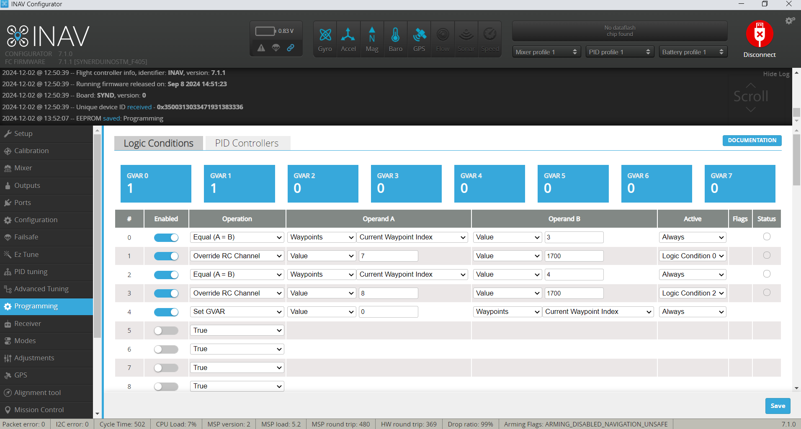
Waypoint Trigger
Waypoint trigger is a function to trigger a servo or a payload function of the drone when the drone reaches a define waypoint to trigger or when conditions are true.
#0 Equal A=B
Current Waypoint index = Value 3
#1 Override RC Channel
Channel Value7 to
Value 1700
Logic Condition 0
#2 Equal A=B
Current Waypoint index = Value 3
#3 Override RC Channel
Channel Value7 to
Value 1700
Logic Condition 2
Set GVAR Value 0
(To help visualize Waypoint)
Current Waypoint index

Slide 36
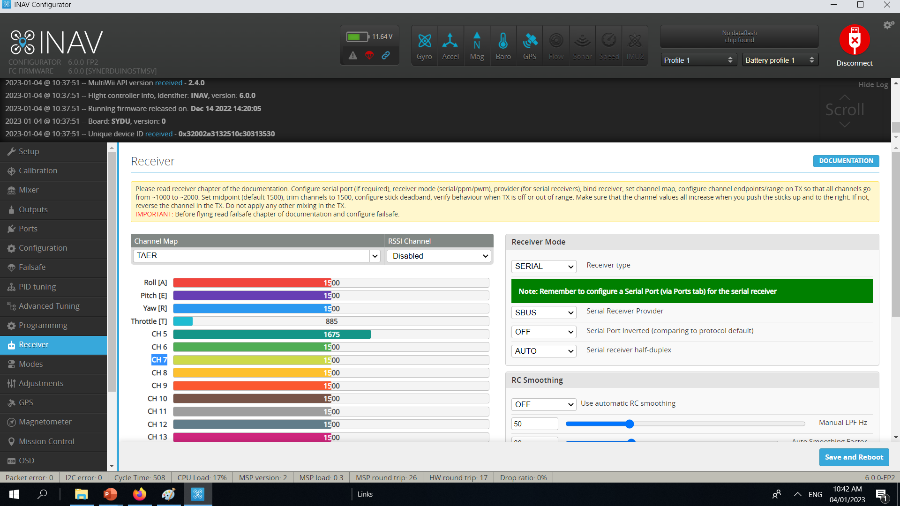
Waypoint Trigger
We Wanted the RC Channel 7 and Channel 8 to be free for the Mode Trigger

Slide 37

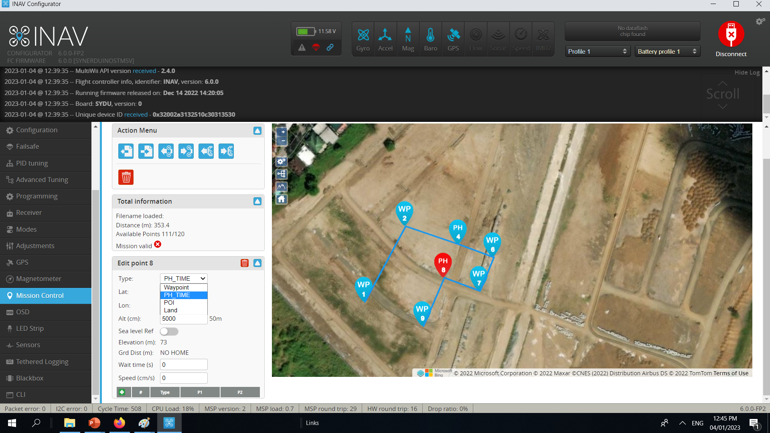
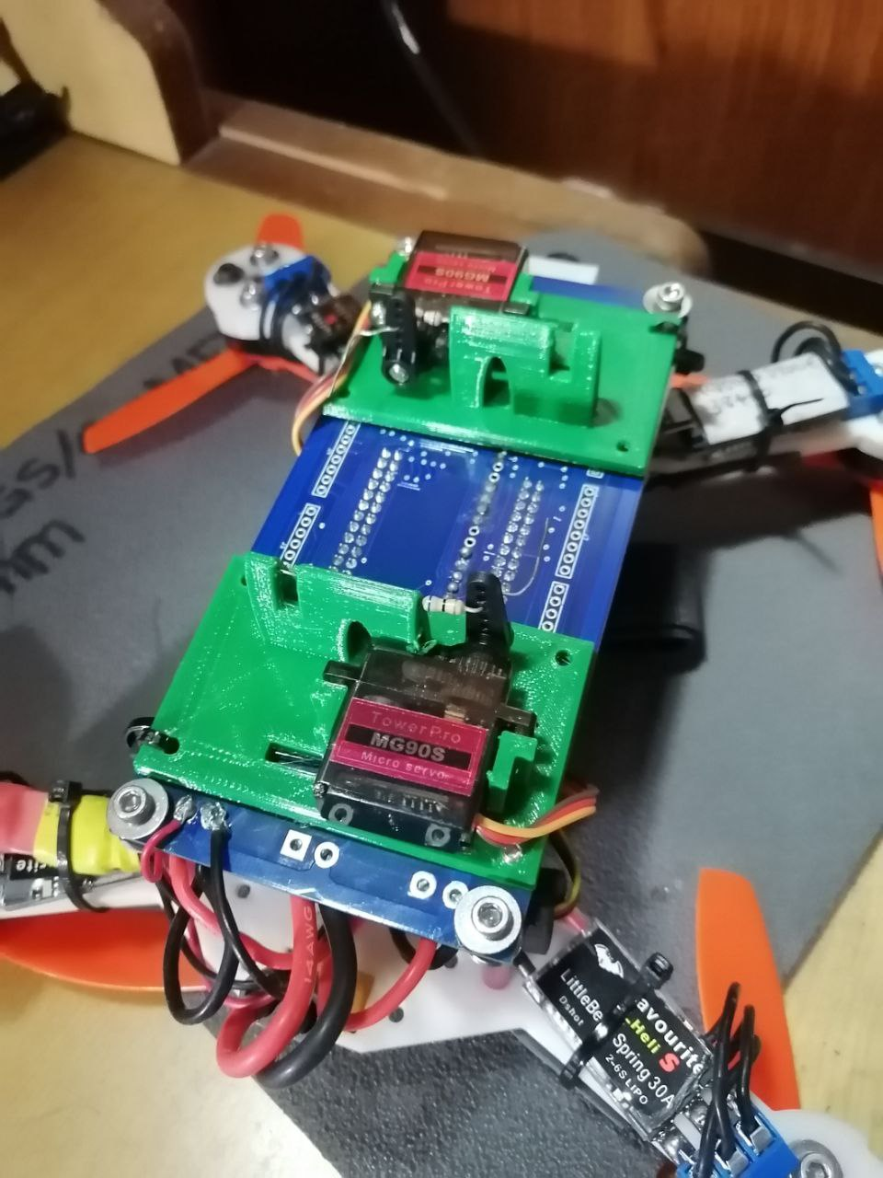
Waypoint Trigger
when the Drone is above the said Waypoint address
In this sample
Servo 1 is trigger by waypoint 3 waypoint index
And
Servo 2 is trigger by Waypoint 4 waypoint index
The payload would Activate

Slide 38

Geofence
This is a means to restrict a drone within a perimeter from its home point
It’s a feature use for beginners to prevent flying too far
In this sample we want to keep the drone with in the 100m radius of an area from home point
0# set GVAR
Operand A = Value 0
Operand B = Flight Home Distance (m)
Active = Always
First we need to visualize Distance from home indicated by GVAR0
1# Greater than
Operand A = Flight Home Distance (m)
Operand B = Value 100(m)
Active = Always
Here we set the value of 100m from home this would be the boundary of the Geofence

Slide 39
Geofence
2# set GVAR
Operand A = Value 1
Operand B = Value 20
Active = Logic condition 1
Here we set our variable when logic 1 condition is triggered, we set GVAR 1 from 20 (2 sec) timer
3# Decrease GVAR
Operand A = Value 1
Operand B = Value 1
Active = Logic condition 4
Here GVAR1 starts the count down
(this countdown only active when Condition 4 is Active)
4# Greater Than
Operand A = Global Variable 1
Operand B = Value 1
Active = Always
If GVAR1 has a Value more than 1 its Status would be Active.
5# Override RC Channel
Operand A = Value 8
Operand B = Value 2000
Active = Logic condition 4
When the conditions are met in Logic #1 with an active Status this would trigger the Value 8 (Ch8) to set PWM to 2000 overriding the RC input and triggering the RTH in Mode. But this mode is only active for 2 seconds then the drone resumes last command. This way it keeps the drone in the 100m Perimeter without doing the complete RTH action.

Slide 40
Geofence
An empty Channel needed to be chosen for the trigger point.
In this case CH8

Slide 41
Geofence
In NAV RTH a channel associated to it needs to be configure to that flight mode
In this case CH8

Slide 42
Gimbal
UBEC is Required for High current applications if it exceeded more than
3A for STMF405 and H743
1.5A for F411 of use when driving servos
BEC input requirements must be 5V
Mainly as Payload like cameras stabilization
Here we can assign Pitch and Roll Gimbal function to the given servo
External ADC Sensor
11.1V Lipo
S7
S8
Any unused Pins can be assigned in the mixer for the task

Slide 43
Gimbal
INAV5-6 In Mixer RC channel 7 is associated to servo1
S1 on SYNERDUINOSTM.HEX
S5 on SYNERDUINOSTMSV.HEX
Logic condition can also be added to the mixer removing the need to add 3# Logic condition in the Programming
Servos can be reverse by giving it a negative value on Weight% -100%
Note: only Applies to INAV5 and INAV6
INAV5 –INAV6 Be aware of your firmware each version has a specific number of servos available for use
1 servo on S7
3 Servos on S5-S7
SYNERDUINOSTM.Hex
SYNERDUINOSTMSV.Hex

Slide 44
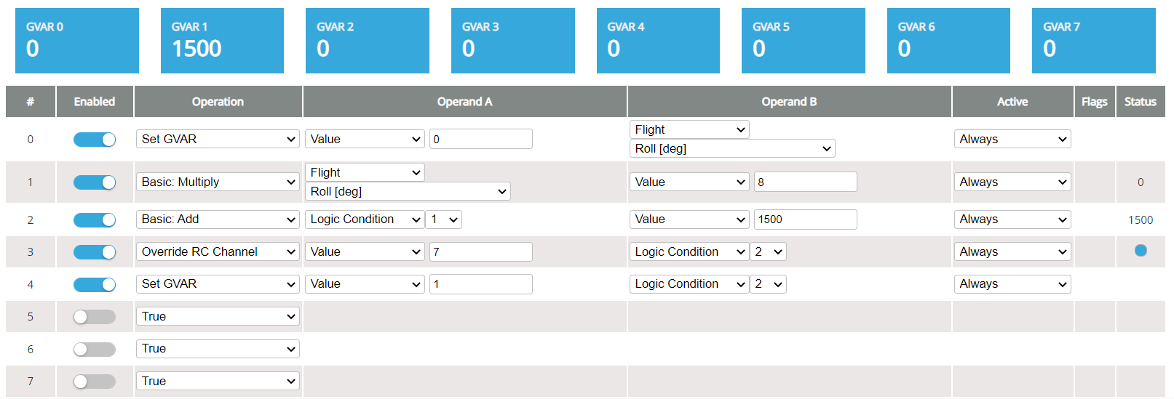
Gimbal
INAV5-6 With Camera or other instrument that Needs Stabilization you can configure Pitch Roll and Yaw Axis available
such can also be augmented by extra channels from your RC when necessary
In this sample with setup a single roll axis
This case we are going to crunch a few math
0# set GVAR
Operand A = Value 0
Operand B = Flight Roll Degrees
Active = Always
GVAR 0 is only for Visual reference to see what the roll degrees indicate when you tilt the drone (can be omitted or remove)
1# Basic Multiply
Operand A = Flight Roll Degrees
Operand B = Value 8
Active = Always
We multiply the roll degree X Value of 8
Ex. (10 Degree Roll X 8) this is also what to adjust when your servo needs alignment by multiplier
Note: only Applies to INAV5 and INAV6
Be aware of your firmware each version has a specific number of servos available for use
1 servo on S7
3 Servos on S5-S7
SYNERDUINOSTM.Hex
SYNERDUINOSTMSV.Hex

Slide 45
Gimbal
INAV5-6
2# Basic Add
Operand A = Logic condition 1
Operand B = Value 1500
Active = Always
Here we keep the Output to 1500 or Centerline 90 degree for servo
3# Override RC Channel
Operand A = Value 7
Operand B = Logic condition 2
Active = Always
Here the servo should respond to the status output on Logic 2 and should tilt to match the degrees tilt of the drone
4# is same as 0# it’s a visualization of logic 2 output
Several chain of similar code set can be applied to Pitch and Yaw axis as well
Note: only Applies to INAV5 and INAV6
Be aware of your firmware each version has a specific number of servos available for use
1 servo on S7
3 Servos on S5-S7
SYNERDUINOSTM.Hex
SYNERDUINOSTMSV.Hex

Slide 46
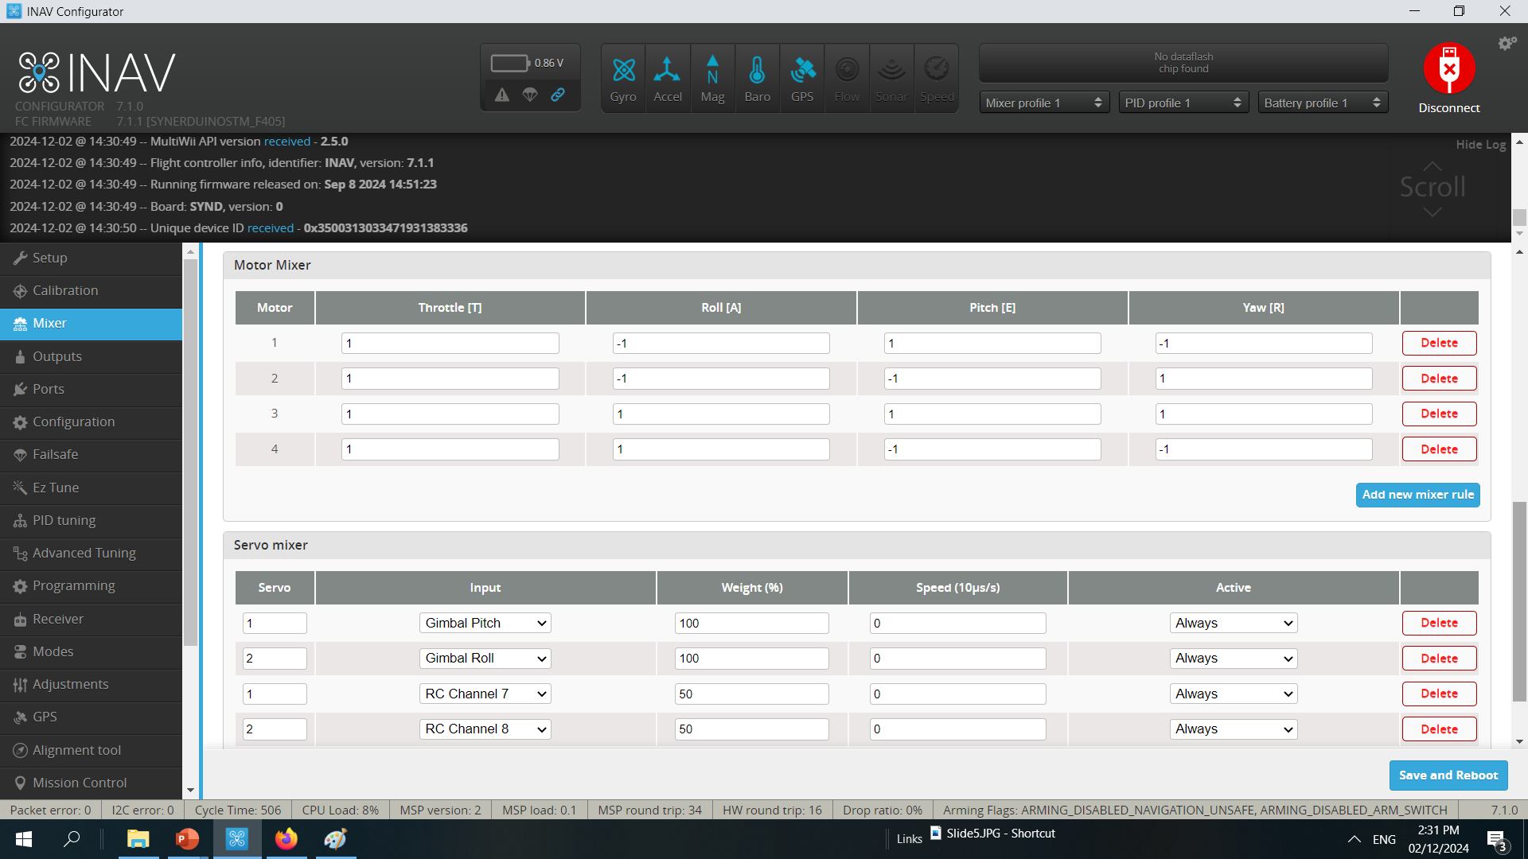
Gimbal
INAV 7 - INAV8
Gimbal Pitch and Roll Assign for servo input 1 and 2 respectively
RC Channel 7 and 8 Respectively controls 50% of the Mixing weight and its useful for adjusting camera angle with Remote Knob Trim control
On Board PWM Pins
S7 – servo 1
S8 – Servo 2
Is assign automatically when save

Slide 47
Gimbal
We Wanted the RC Channel 7 and Ch 8 to be free for the gimbal function override
Which also doubles as a Pitch control if you wanted to adjust the angle of the camera

Slide 48

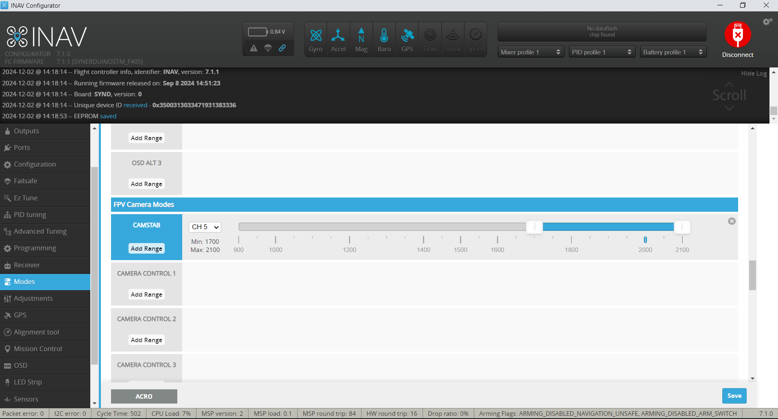
Gimbal
INAV 7 - INAV8
For Gimbal function to work you need to be active in the FPV camera Mode

Slide 49
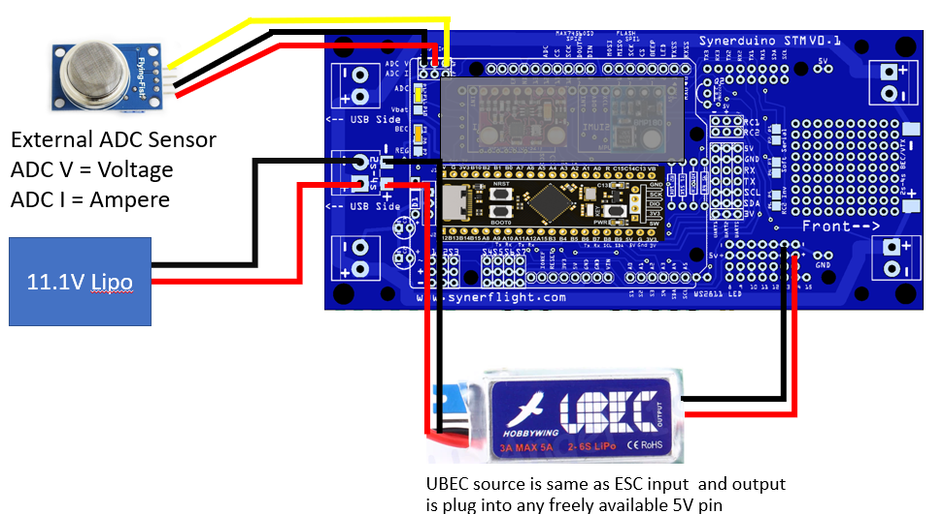
Data Analytic Intervention
As the name suggest if you know what you're looking for and you want the drone to intervene /Do something when it met a condition. doing the mission whether is triggering a payload or instrument when a potential positive value is match
For this sample we Hook up a sensor into the ADC V or ADC I
P12-P11 : ADC –this is use for having an external Analog sensor installed as it reads 0V-5V for Synerduino to convert to a Global Variable

Slide 50
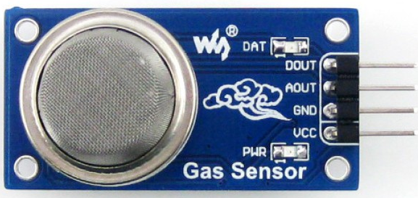
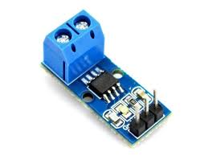
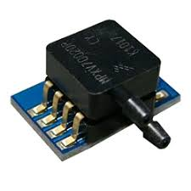
Data Analytic Intervention
UBEC is Required for High current applications if it exceeded more than
3A for STMF405 and H743
1.5A for F411 of use when driving servos
BEC input requirements must be 5V
Primary with 4 ADC pins
Voltage
Current
RSSI
Airspeed
External ADC Sensor
11.1V Lipo
This can be reassign for any Analog sensors outputting 0V -5V

Slide 51
Data Analytic Intervention
Similar Low battery failsafe the DAI Starts by configure your Battery Cell Count ,Current and Voltage scale this way you can adjust to your sensors while calibrating the value output.
Note: its best to use a 2nd sensor acting as controlled to a specimen in order to calibrate its output
But in this case instead of the Battery its ADC sensor data we would input or Companion Controller input
This would define your signal point on where to trigger.
ADC V (Battery Voltage Monitoring ) could be Sensor 1
ADC I (Battery Current Monitoring ) could be Sensor 1

Slide 52
Data Analytic Intervention
We Wanted the RC Channel 7 to be free for the Mode Trigger this would be active when a sensor value is met

Slide 53
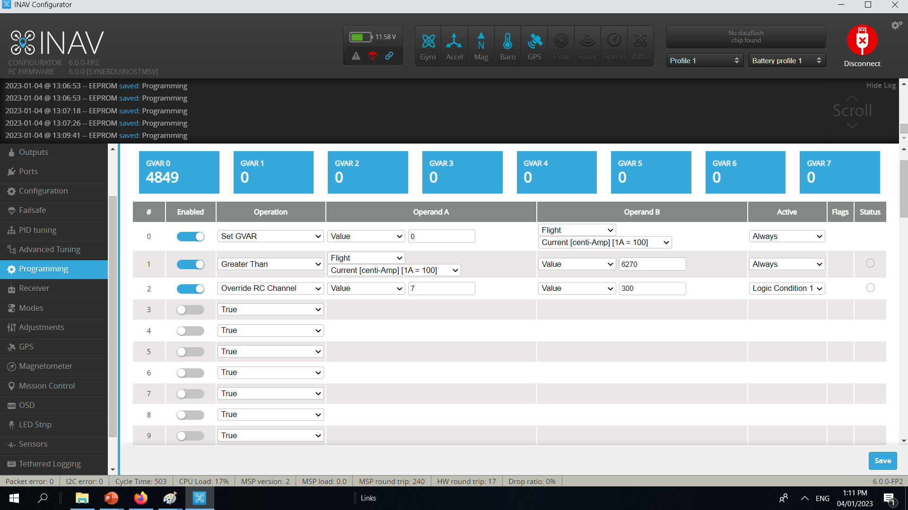
Data Analytic Intervention
In this sample we use ADC I (Flight Current) as a sample where we hook up the sensor to
0# set GVAR
Operand A = Value 0
Operand B = Flight Current / Vbat Volt
Active = Always
First we need to visualize the Current input in this case GVAR0 4849
1# Greater than
Operand A = Flight Current / Vbat Volt
Operand B = Value 2670
Active = Always
Operand B can be change depending on the sensor value want to trigger from
2# Override RC Channel
Operand A = Value 7
Operand B = Value 200
Active = Logic condition 1
Here is where the magic happens when the conditions are met in Logic #1 with an active Status this would trigger the Value 7 (Ch7) to set PWM to 200 overriding the RC input and triggering the servo or Payload

Slide 54
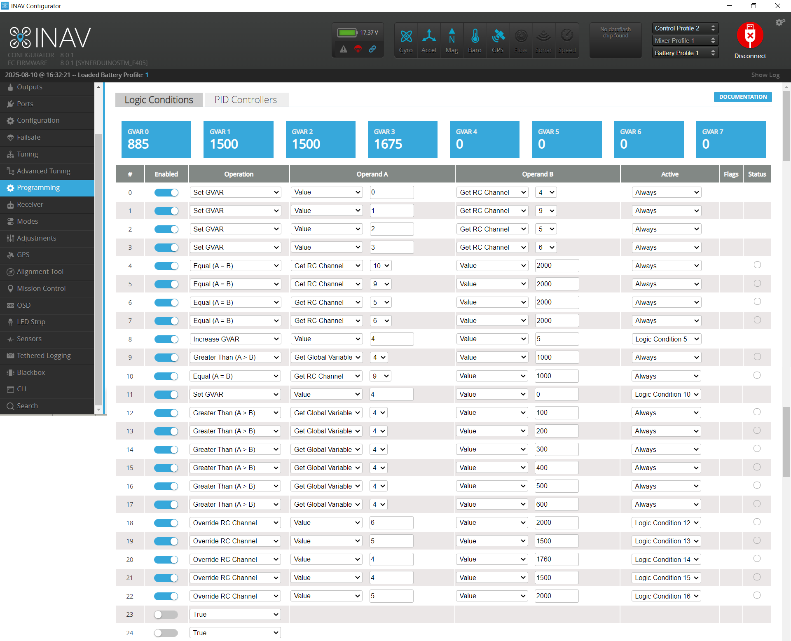
Auto Take off and Do missions
This involve multiple segments
0-3 Ser Global Variable – this to see the status
Assign Modes to this as well
Get RC Channel 4- throttle
Get RC Channel 9- Run Code Switch
Get RC Channel 5- GPS POS - WP Mission Switch
Get RC Channel 6- Arm Switch
4 - 7 RC channel initialization
this also Triggers key Logics as to be used by timer
8 – 11 Timer
On Code run switch it starts the clock which triggers the timer sequence this also use to reset timer when deactivated
12-17 Key frame markers for the timer to trigger
18-22 the override RC channel sequence which is trigger by the timer see how it the logic conditions looks at the key frame markers as reference

Slide 55
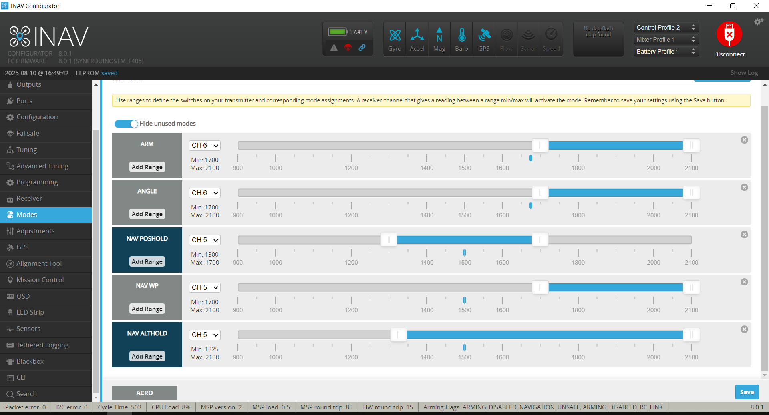
Auto Take off and Do missions
Ch6
Arm Arm the drone
Angle this keeps the drone stabilize
Ch-5
Nav Althold – Altitude hold
Nav Poshold –GPS hold
Nav WP - Mission
Note: Exiting this Auto Take off and mission while the drone in flight requires the arm switch to on 2000
And Poshold switch to be at 1500 on your transmitter
This would put the drone on GPS hold for manual control

Slide 56
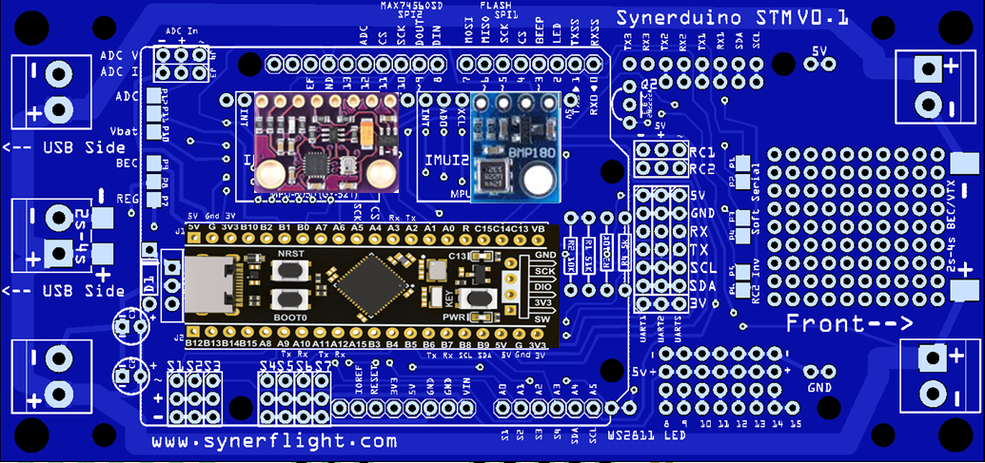
Companion board
There are several reason you may add a companion controller or computer to perform tasks separate from the Synerduino but need to be able to communicate with it to perform fight modifying action or Data Logging or even extended sensor array that is more than the standalone synerduino board physically accommodate
For Companion board add on options there are several Levels of installation
ADC – Analog 0V-5V input
Sbus/PWM – RC PWM 50 hz
Serial – MSP Telemetry
PWM Output
11.1V Lipo
UBEC may be needed to add extra current to power a companion board source is same as ESC input and output is plug into any freely available 5V pin

Slide 57
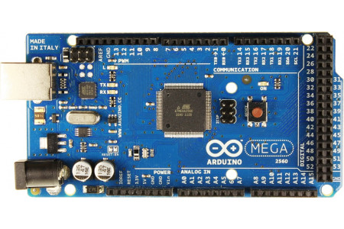
ADC Companion
F411 The is useful for analog base inputs
PWM, or pulse width modulation is a technique which allows us to adjust the average value of the voltage that’s going to the electronic device by turning on and off the power at a fast rate.
This method is the most simplest interface that one can incorporate even the most basic of logic circuits for simple tasks
Arduino Mega
D12 (ADC V) D13 (ADC I) D12 is align to the Synerduino V0.1 board ADC pin directly
Analog pins A10 ,A11 ,A12,A13 , A14 are free for Sensor inputs
DIY prototyping segment are also free for other Digital pins directly below it
Motor PWM pins are also connected to the Analog pin S1-A0 S2-A1 S3-A2 S4-A3 as feedback loop to read pwm data off the motor

Slide 58
ADC Companion
F405 and H743 The is useful for analog base inputs
PWM, or pulse width modulation is a technique which allows us to adjust the average value of the voltage that’s going to the electronic device by turning on and off the power at a fast rate.
Arduino Mega
Analog pins A8 ,A9 ,A10,A11 are free for Sensor inputs
DIY prototyping segment are also free for other Digital pins directly below it
Note: pls be aware of the ADC pins Location they may Vary from board to board

Slide 59
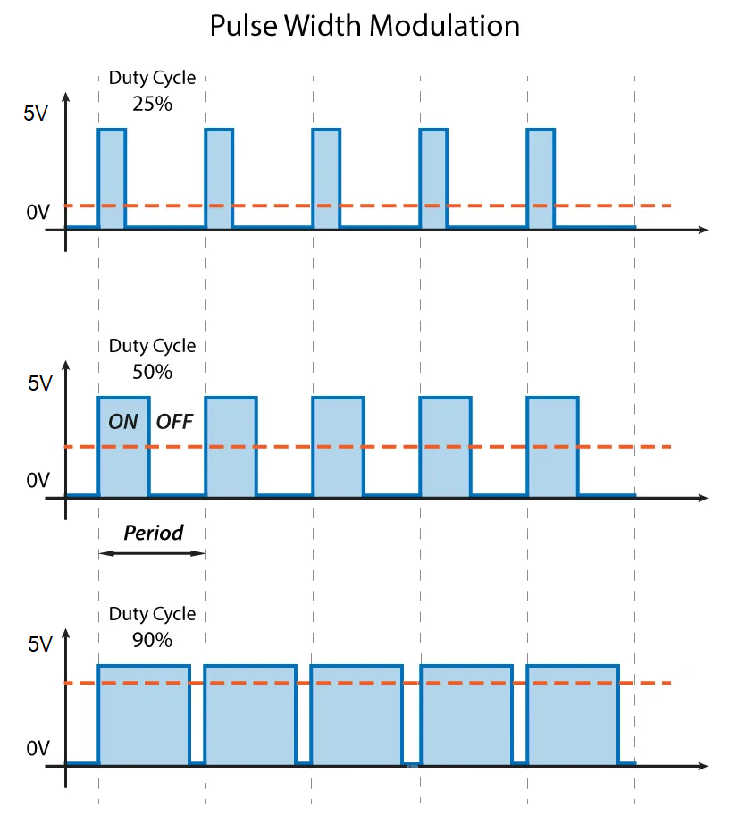
ADC Companion
The average voltage depends on the duty cycle, or the amount of time the signal is ON versus the amount of time the signal is OFF in a single period of time.
This works with most Arduino PWM motor driver scripts

Slide 60
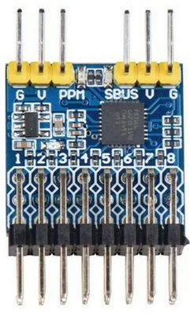
SBUS/PWM Companion
In the world of Robotics /RC /Drones
There is always a standard of PWM called the RC PWM its set at 50hz
And range from 1000us to 2000us
Of pulse this controls the value of the servos
This is said to be useful as interface when you need to have a semi digital range you want to instruct vehicle to do
Analog pins A10 ,A11 ,A12,A13 , A14 are free for Sensor inputs
DIY prototyping segment are also free for other Digital pins directly below it
Motor PWM pins are also connected to the Analog pin S1-A0 S2-A1 S3-A2 S4-A3 as feedback loop to read pwm data off the motor
This Setup requires an SBUS/PPM/PWM converter
Arduino D12 Ch7 (ADC V)
Arduino D13 Ch8
RC Inv must be connected

Slide 61
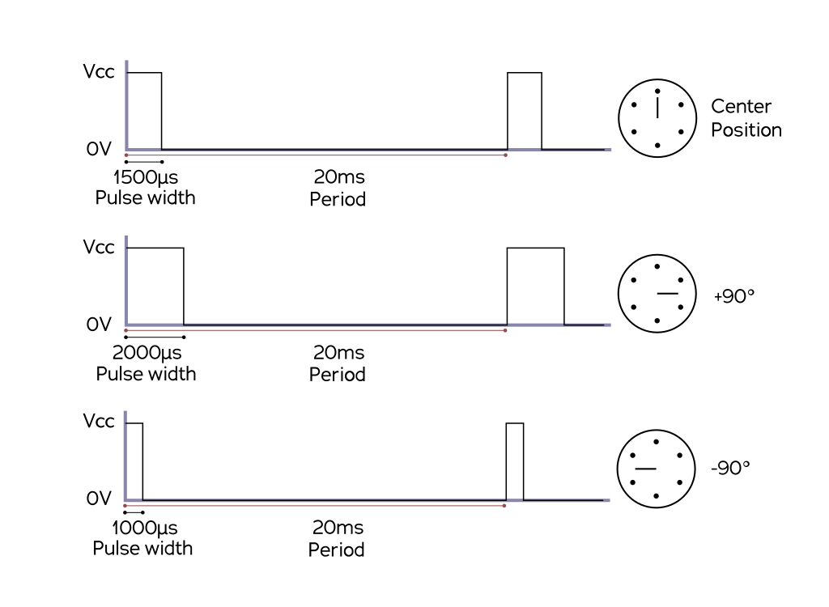
SBUS/PWM Companion
As RC servo standard this can be taken as an advantage for multiple data points for inputs
This works on Most Arduino Servo Scripts

Slide 62
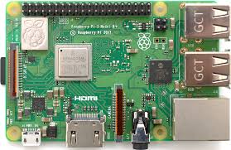
Serial Companion
This is mostly done with Companion computer boards like Raspberry pi , Jetson Nano for higher levels of processing and applicable for larger vehicle platforms that can carry an extra onboard weight
Raspberry Pi UART is P8 TX(GPIO15) P10 RX(GPIO16)
Soft serial must be activated as Serial to utilize the UART pins on the Synerduino
Note: the Raspberry Pi 3 does come with a bluetooth an alternative Bluetooth connection can be done should weight and size is a concern and use the companion board as ground station instead
you can also utilize the other GPIO pints for the ADC input as well with raspberry pi

Slide 63
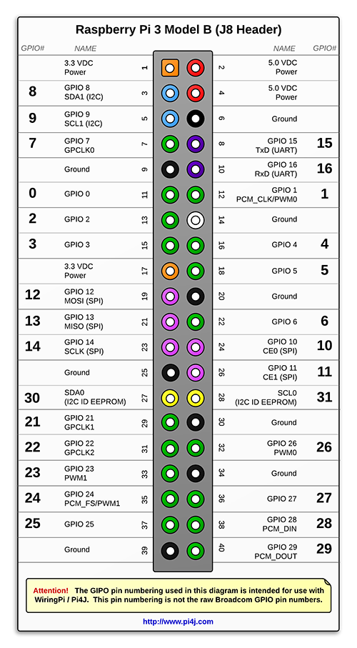
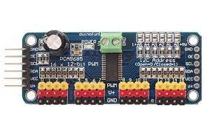
GPIO Companion
The P3(GPIO8) & P5 (GPIO9) can be utilize to drive an servo module which is run thru an converter then feeds the Sbus
Note: Apart from serial the GPIO pins of the raspberry can also work in conjunction of the 12bit i2C servo module and Sbus/PPM/PWM Converter

Slide 64
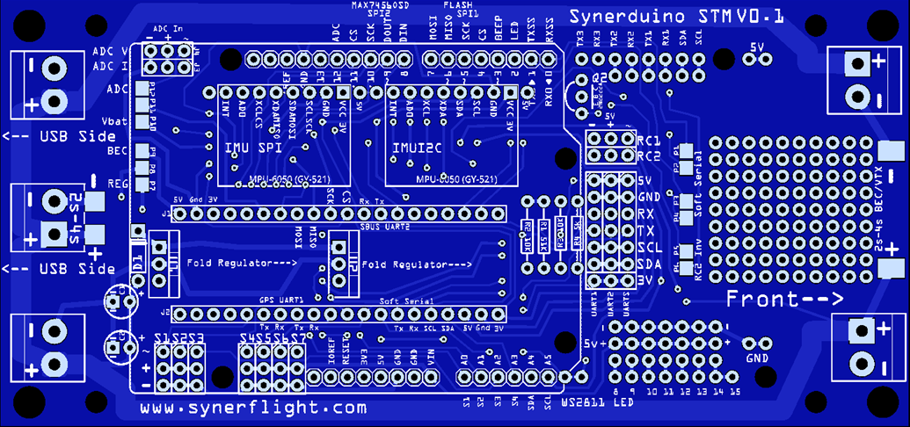
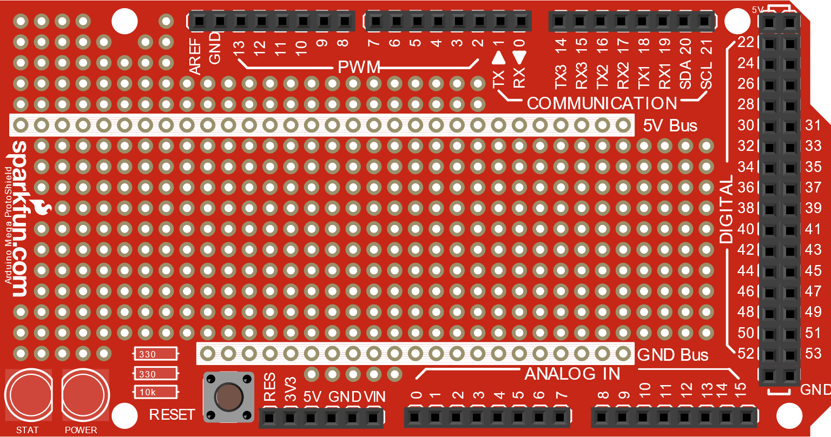
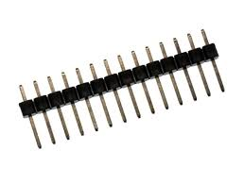
SYNERDUINO STM and PROTOTYPING BOARDS
Since Synerduino is design as a shield board with an Arduino footprint its self means its compatible with a wide range of other shield prototyping board as well making it easy to fit custom or add on hardware reducing the need of additional wires and connectors
Male Headers are installed on the bottom of the board as required.
Prototyping Shield are to be place on the under side of the board

Slide 65
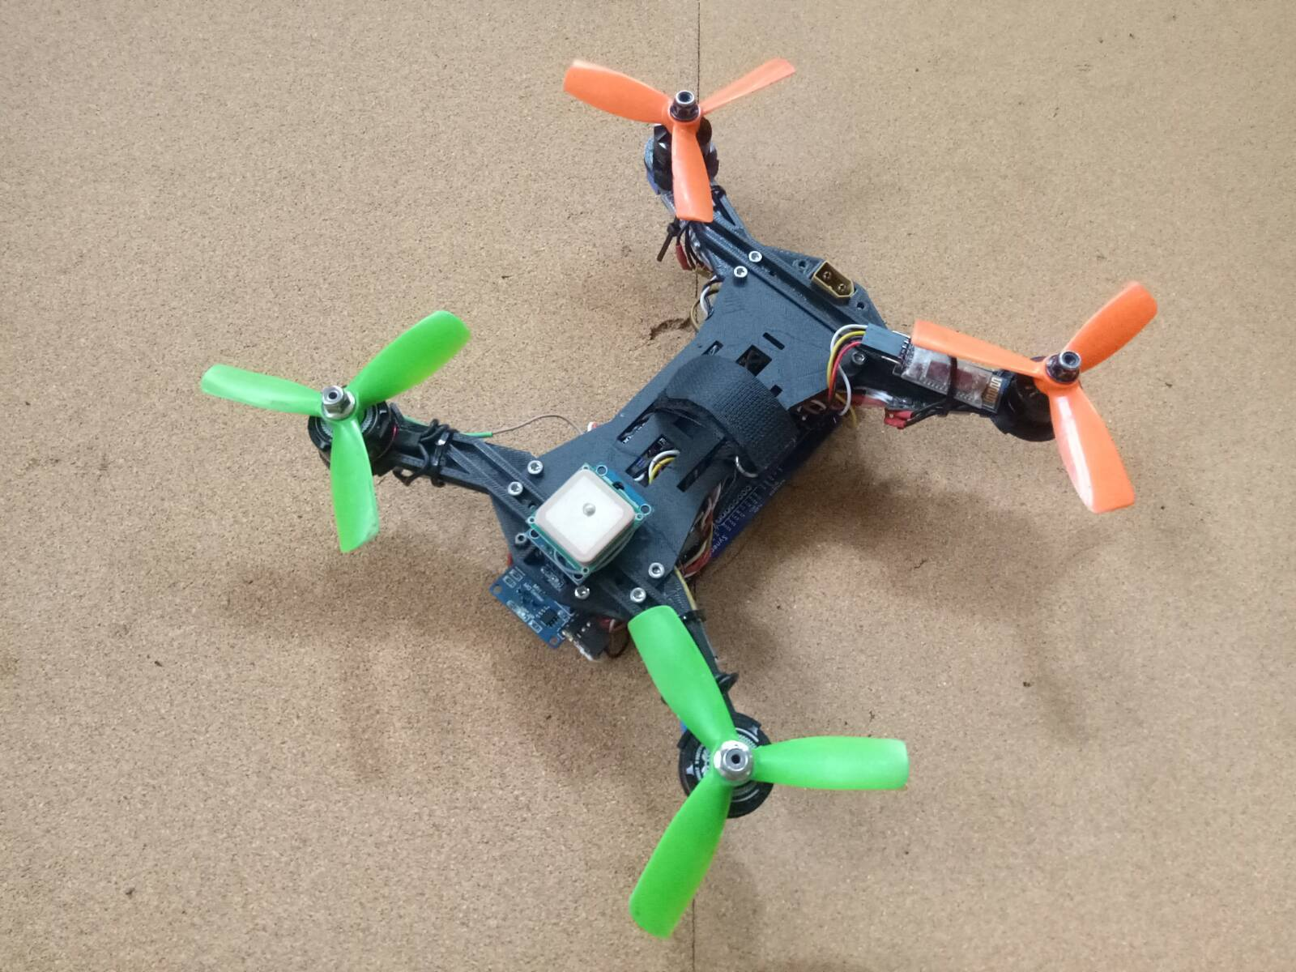
Final note: Program Logic is a very useful tool for Drone Vehicles it allows users with a wide flexibility to configure their Drone Vehicle’s action and utilization of add on hardware as well . This sample is just a small slice of what can be done
Caution: Flight modification Flight modes entered in the Logic should be carefully studied and when testing fly slow 2 m/s and low 2meters both on missions or manually . Please attach tether when possible.
Avoid putting any Logic on Channel use by Arm/Disarm mode (this is your emergency shutoff switch)
RTH , Navigation modes , Arm/Disarm, Override (Ch1,2,3,4,5)
Multiple lines of code can also be stacked to form a instruction set for your vehicle which could accommodate companion board and daisy chaining of multiple synerduino boards
Thank you

